Slide 1
Early Detection of Alzheimer’s disease
Ramin Nourizadeh

Slide 2
Table of Contents
Introduction to Protein
Recent advances in protein design,
shifting from a physical-based function paradigm to one that uses deep learning
Discuss challenges to the design of marketable proteins with controllable properties.

Slide 3
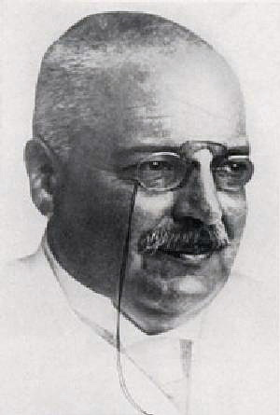
Introduction
AD
Alois Alzheimer
Notes:
Alois Alzheimer (1864 –1915) was a German psychiatrist and neuropathologist

Slide 4
Introduction
AD Stages
approximately 15–20% of MCI patients progressing to AD each year

Slide 5
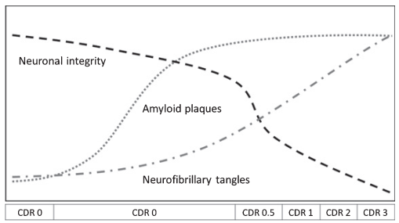
Introduction
AD diagnosis methods
biological markers, such as amyloid-beta (Aβ) protein accumulation, which is distinctive in AD, may be found in the brain up to 20 years before the stage of dementia

Slide 6
Introduction
AD Stages
it has been established that SCD can occur at late stages of preclinical AD, before MCI is reached. This phase can be also referred to as pre-MCI or preprodromal AD.
probability of Aβ positivity of up to 0.75 for patients with MCI and of 0.60 for SCD subjects

Slide 7
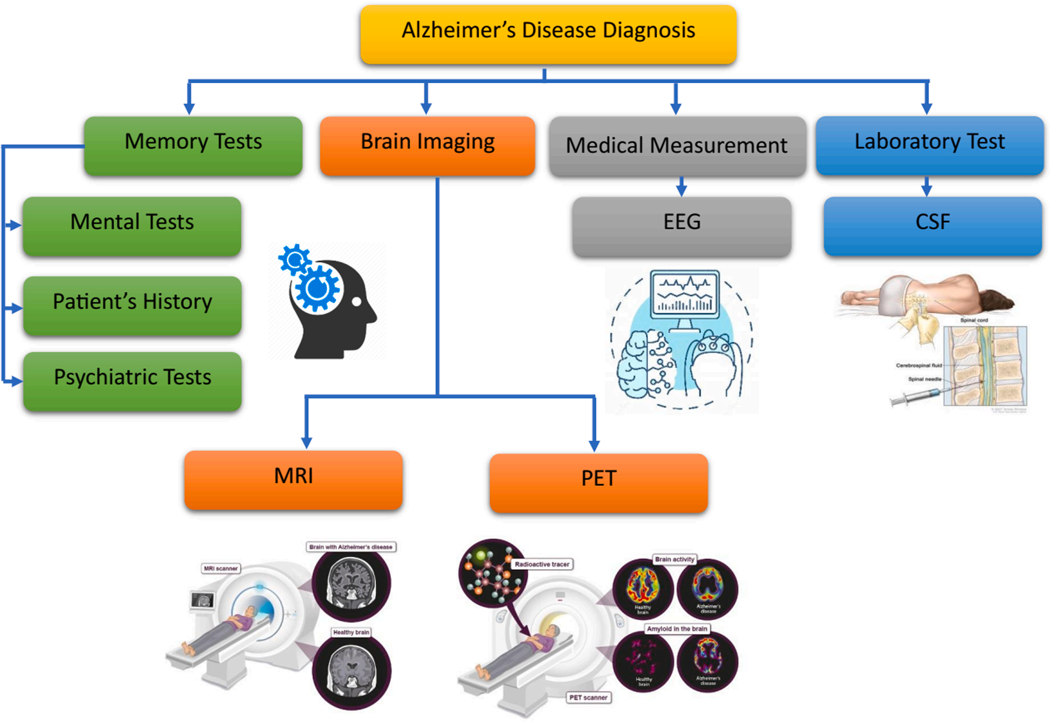
Introduction
AD diagnosis methods

Slide 8
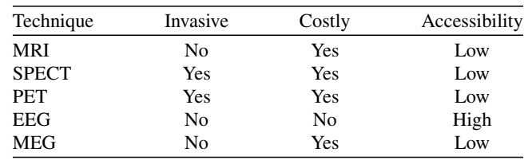
Introduction
AD diagnosis methods
Comparison of the medical techniques described in the Introduction section

Slide 9
Introduction
AD diagnosis methods
medical imaging techniques
images are typically segmented into voxels and features are extracted
EEG is processed in the time and the frequency domains.
MRI, CT, and PET, EEG recording methods provide good temporal resolution

Slide 10
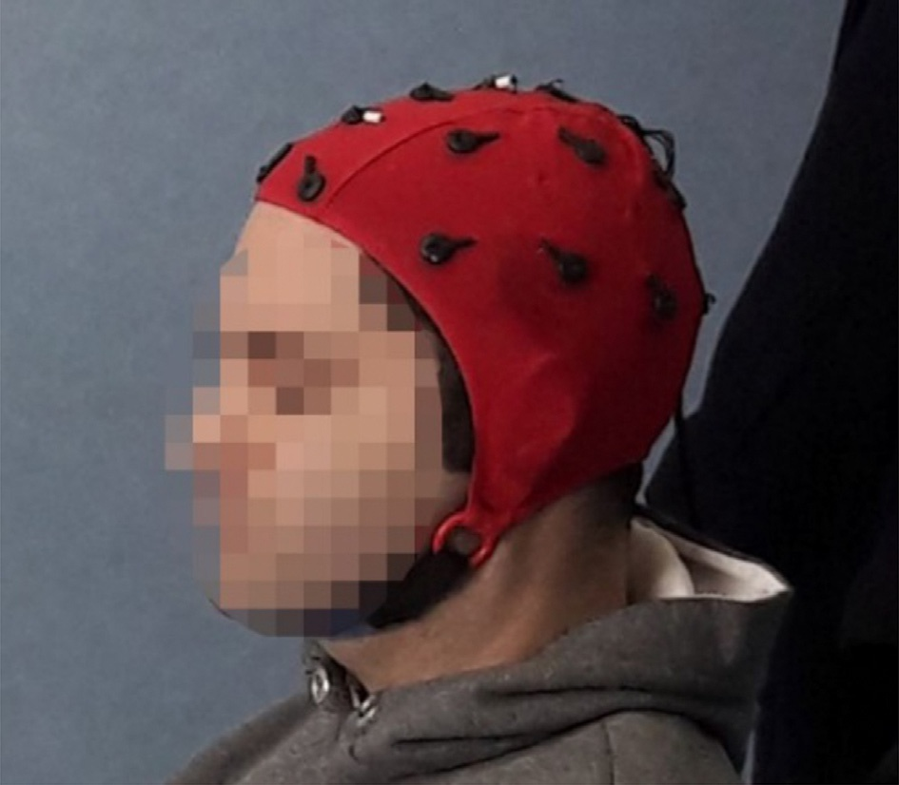
Introduction
AD diagnosis methods
The EEG electrode placement was standardized in a 10–20 system, which is a method to describe the location of electrodes over the scalp. This system is based on the relationship between the location of the electrode and underlying brain lobes. The distances between adjacent electrodes are either 10% or 20% of the total front-back (nasion-inion) or right-left distance of the skull. large interelectrode distance.

Slide 11
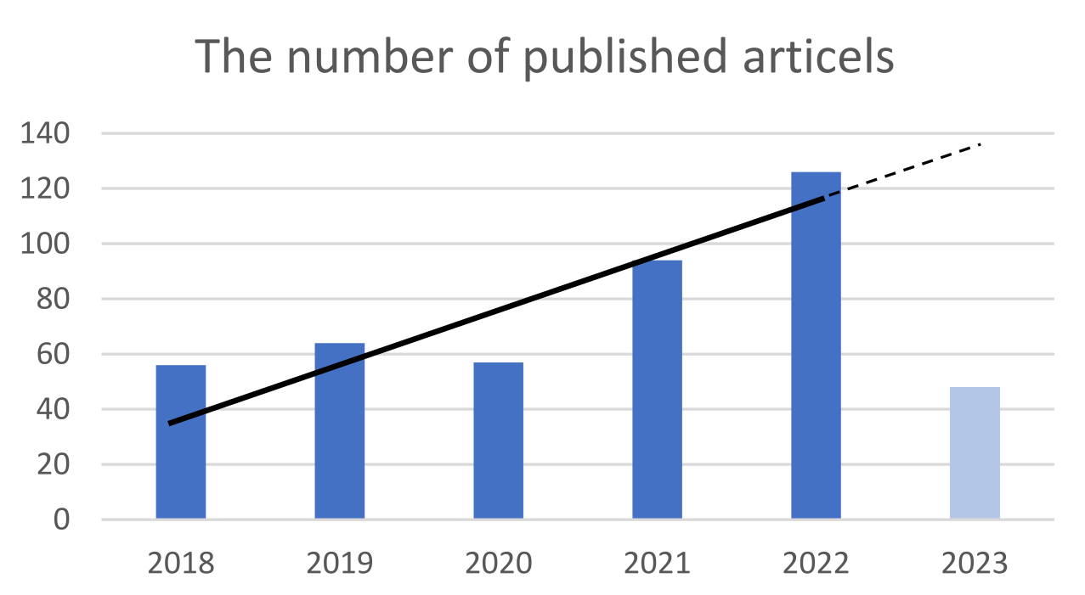
Introduction
AD diagnosis methods

Slide 12
Introduction
Dataset
More than 95% of the studies that focused on EEG-based classification were conducted with fewer than 100 participants.
public medical imaging databases like ADNI or OASIS is a common practice in AD literatures
in EEG studies, due to the high accessibility of this technique, researchers generally acquire their own data
the number of subjects varies across different studies, from 11 to 336. Only 13 out of 72 studies consist of more than 100 participants, therefore most of these studies have a relatively small number of participants which could limit their generalizations

Slide 13
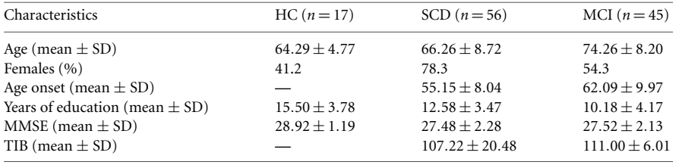
Introduction
Dataset
Clinical-demographic characteristics of population

Slide 14
Introduction
Dataset
the need to provide an open-access and proper EEG database for the problems in the realm of AD disease is clearly observed.Although an open-access MRI and fMRI database exists in the field of AD it is not available for EEG to the best of our knowledge
Almost all the researchers applied their own database and it makes the comparison among the performance of studies very challenging

Slide 15
Introduction
EEG
EEG changes related to AD progression into four main categories:
slowing,
complexity reduction,
synchronization decrement and
neuromodulatory deficit
These effects include EEG slowing, loss of synchronization, and complexity reduction

Slide 16
Introduction
EEG
Electroencephalography signals (EEG) are a method of detecting electrical activity in the brain
changes can include increased slow brainwaves (delta and theta waves) [20] and decreased faster waves (alpha and beta waves)
an increased Theta/Alpha ratio has also been reported for subjects with mild AD
can be used to monitor changes in brain activity associated with the progression of the disease and help doctors adjust treatments and make better decisions.

Slide 17
Introduction
EEG
EEG has several disadvantages as well. The most important of which are noisy raw data [16], high inter-subject variability [17], and low spatial resolution [18]. Artifacts from many nonphysiological sources such as power line, bad electrode contact, broken electrodes, etc. and physiological sources such as cardiac pulse, muscle activity, sweating, movement, etc.

Slide 18
Introduction
EEG
The input fed to the deep neural network has varied from simple band segregated data (alpha, beta, gamma, etc.) to simple features like mean, variance, etc. of the band power to much more complex features like PLV and PLI. Thus, we can conclude that EEG poses a unique challenge of complex pre-processing and feature selection mechanisms

Slide 19
Introduction
EEG Recording
EEG signal was recorded at 200 Hz
In a 10-min eye-closed resting state
Participants were required to remain awake during the entire recording
Standard 16-channels montage was utilized according to the 10–20 International System.
Recording resting-state EEG data is easier, more practical in real-world circumstances, and more comfortable, especially for the elderly.

Slide 20
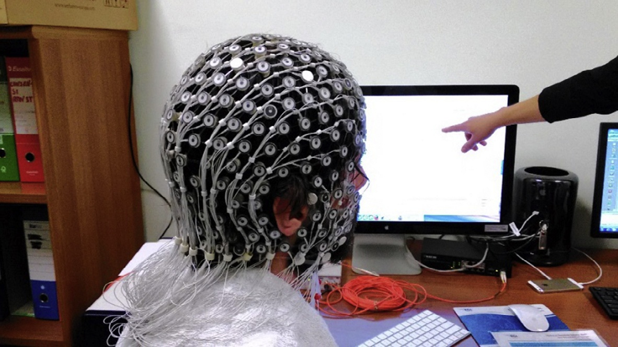
Introduction
EEG Recording
With a standard 10–20 system, the average intersensor distance is 7cm. Achieving a 1 to 2cm sampling density would require 500 EEG channels distributed uniformly over the scalp. High-density-EEG (HD-EEG) offers a high temporal resolution, typical of EEG, in conjunction with a high spatial resolution (Fig. 8). HD-EEG with 256 channels provides adequate approximate spatial sampling [23,24]. An example of high-density EEG recording is shown
High-density 256 channels EEG recording system

Slide 21
Introduction
EEG Recording
T3, T4, T5, and T6 channels that are located in the temporal area showing the most significant performance in a three-way classification of HC, AD, and MCI. Furthermore, the O1 channel illustrated a sharp reduction in the performance of he classification according to EEG-based features in δ and θ frequencies in AD patients and it showed the roll of occipital area in AD and MCI .
FP2, Fz,F3, Pz, TP7, and T5 channels were found to provide the best performance in MCI classification while occipital channels were not found efficient in this issue

Slide 22
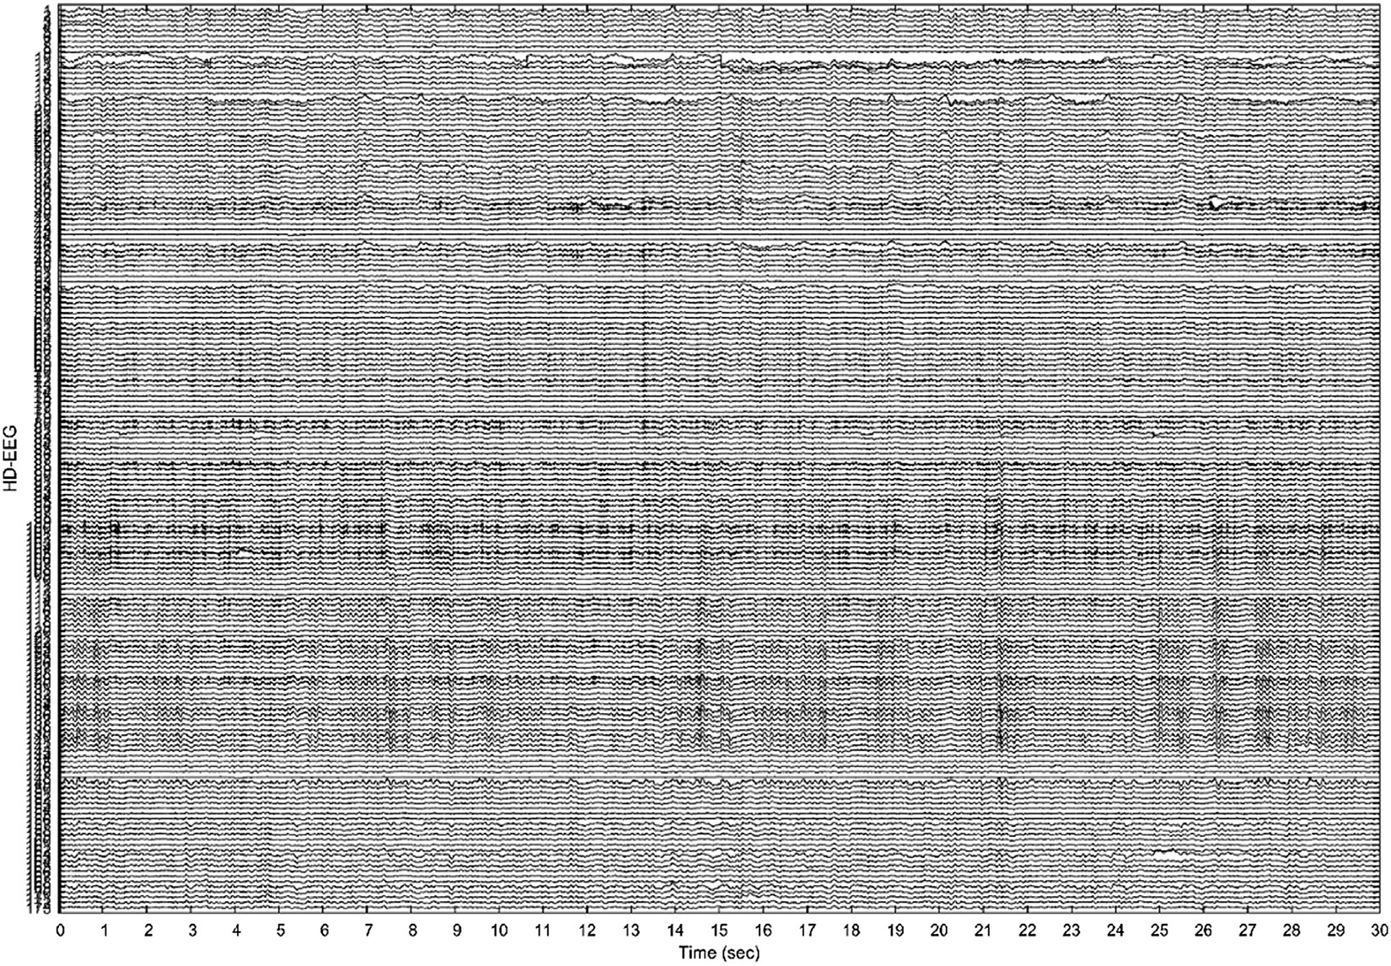
Introduction
EEG Recording
A 30 s sample of high-density 256 channels EEG recording

Slide 23
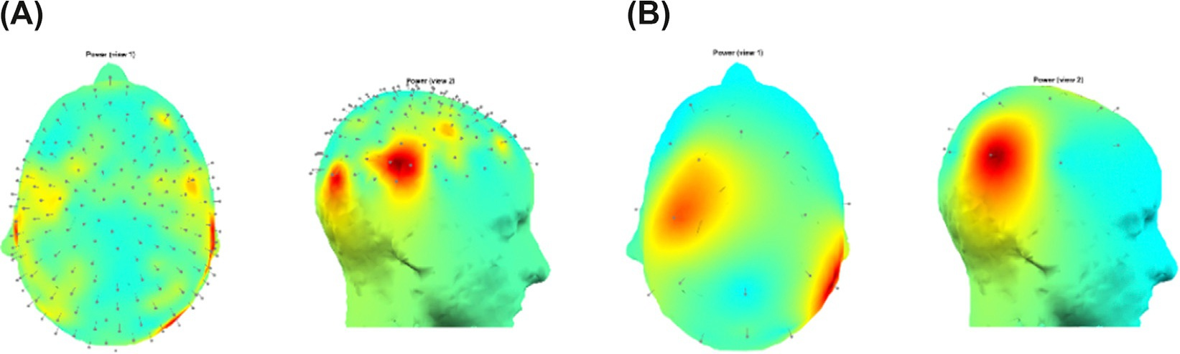
Introduction
EEG Recording
3D scalp topography of the power of the EEG recording is shown
standard 19 channels

Slide 24
Introduction
EEG Preprocessing
Filtering and EEG rhythm calculation, artifact reduction algorithms, expert supervision, data reduction, baseline correction, re-referencing, interpolation, region of interest (ROI) definition, source localization, data augmentation, normalization, and input generating for Deep Neural Network (DNN) are in the realm of pre-processing techniques and have been investigated for AD assessments
almost all the studies have employed band pass filter or discrete wavelet transform (DWT) to remove some artifacts that lie in a limited frequency band or specific artifacts

Slide 25
Introduction
EEG Preprocessing
Input generation for a deep neural network (DNN) is another pre-processing step generating a two-dimensional matrix or image as the input of a DNN . For this purpose, EEG signals have to be converted to a trajectory matrix or an image in a certain procedure summarized in Table 3. These techniques mostly convert time-domain EEG signals to frequency or time–frequency information

Slide 26
Introduction
EEG Preprocessing
Defining the length of the processing window is the last procedure in the pre-processing stage. Long-time signals have to be segmented into the fix time epochs for applying in the main processing stage. This time length directly depends on the recording protocol and main processing technique. The determining of the window size is essential. It should be long enough to be informative about the dynamic of the system and fulfill the processing method. Long processing windows, on the other hand, can violate some assumptions such as stationarity and also increase the computational cost. Therefore, finding a fit window size is an art.

Slide 27
Introduction
EEG Preprocessing
Feature selection, dimension reduction, normalization, and feature rebalancing techniques are the post-processing procedure
Dimension reduction can increase the machine learning performance when a machine faces a large set of data [123]. Principal component analysis (PCA) converts that large dataset to a reduced one by containing the prominent information
Totally, in 27% and 62% of the research articles statistical evaluation and machine learning techniques have been applied respectively

Slide 28
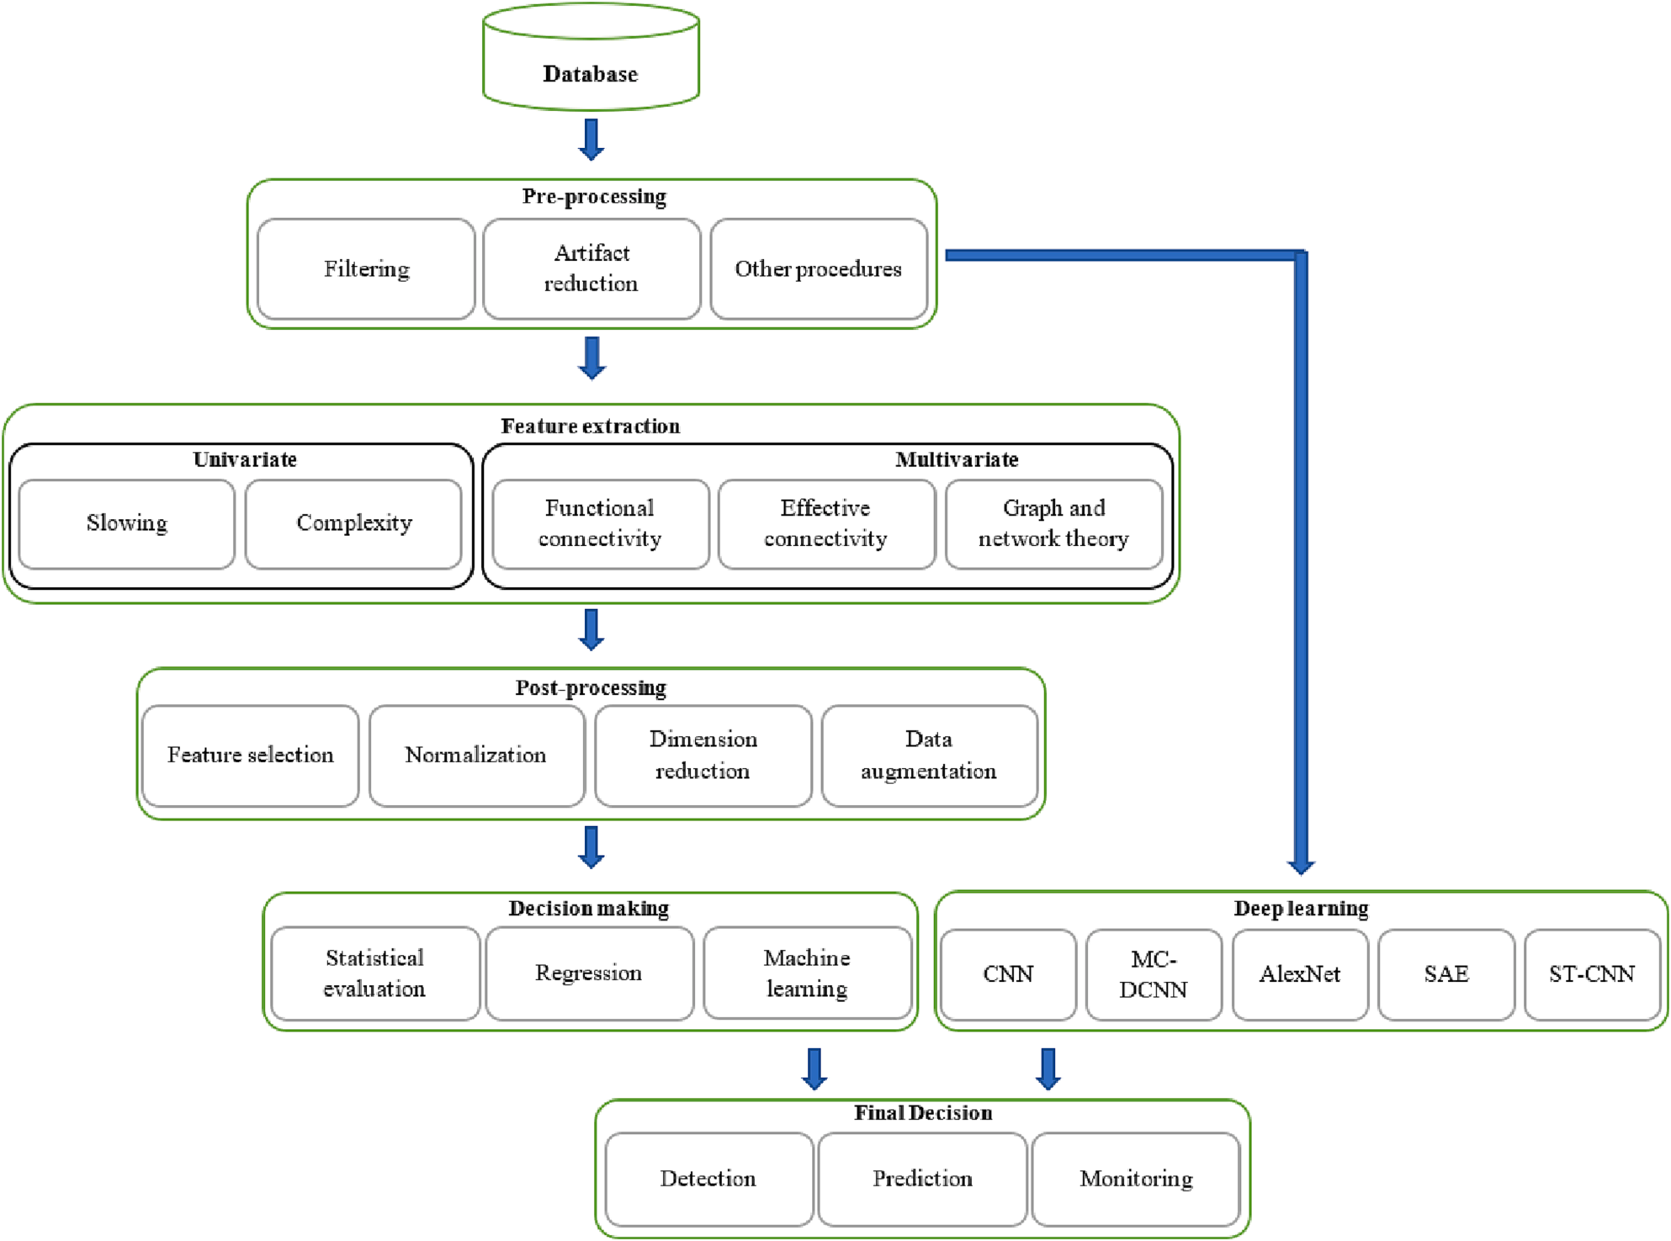
Introduction
EEG Processing
The structure of AD detection, monitoring, or prediction researches based on EEG signal processing.

Slide 29
Introduction
EEG Processing
Deep learning techniques in AD assessment:
Convolutional neural network (CNN)
MC-DCNN
AlexNet
Stacked autoencoder (SAE)
Spatial Temporal Convolutional
Networks (ST-CNN)

Slide 30
Introduction
Alzheimer
Patients with MCI and AD generally showed decreased alpha/beta power and increased theta/delta power in a broad range of brain regions such as frontal, temporal, parietal, and occipital areas

Slide 31
Introduction
Alzheimer
stated that 30% of people are misdiagnosed
Mentioning the type of MCI is also important in the realm of EEG-based detection since aMCI affects the hippocampus and is detectable in MRI while it is not easy for naMCI. Therefore, naMCI via an EEG-based biomarker can be more valuable
Diagnosing severe and moderate AD is not a very challenging issue for neurological clinicians, while detection of Mild AD, CI due to AD, and pre-clinical stage of AD can be more problematic.

Slide 32
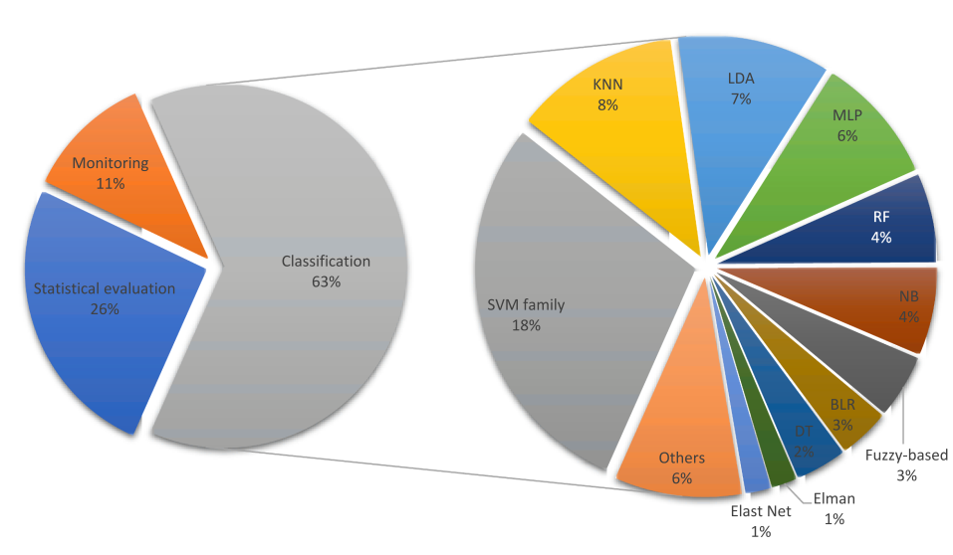
Introduction
Alzheimer
This pie chart of the percentages of Decision-making approaches. Abbreviations: Support Vector Machine (SVM), K-Nearest Neighbor (KNN), Linear Discriminant Analysis (LDA), Multilayer Perceptron (MLP), Random Forest (RF), Naïve Bayse (NB), Binary Logistic Regression (BLR), Decision Tree (DT)

Slide 33
Introduction
EEG Recording
EEG signal was recorded at 200 Hz
In a 10-min eye-closed resting state
Participants were required to remain awake during the entire recording
Standard 16-channels montage was utilized according to the 10–20 International System.
EEG can capture neural events in the order of milliseconds , but its spatial resolution is limited by the number of electrodes used to record the electrical activity of the brain.
EEG is noisy and nonstationary multivariate time series

Slide 34
Introduction
EEG Recording
The EEG electrode placement was standardized in a 10–20 system, which is a method to describe the location of electrodes over the scalp. This system is based on the relationship between the location of the electrode and underlying brain lobes. The distances between adjacent electrodes are either 10% or 20% of the total front-back (nasion-inion) or right-left distance of the skull. large interelectrode distance.

Slide 35
Introduction
EEG Processing
A wavelet transform reveals important information in a signal’s time–frequency domain through analysis of frequency components.

Slide 36
Introduction
EEG Processing
Considering the complexity of EEG signals, classifier models should be reduced to more straightforward features that can be calculated.

Slide 37
Introduction
EEG Processing
four stages:
data acquisition,
signal denoising,
feature extraction,
classification.

Slide 38
Introduction
EEG Processing
The five frequency bands of B were defined as:
Delta: 0.5 – 4 Hz
Theta: 4 – 8 Hz
Alpha: 8 – 13 Hz
Beta: 13-25 Hz
Gamma: 25-45 Hz

Slide 39
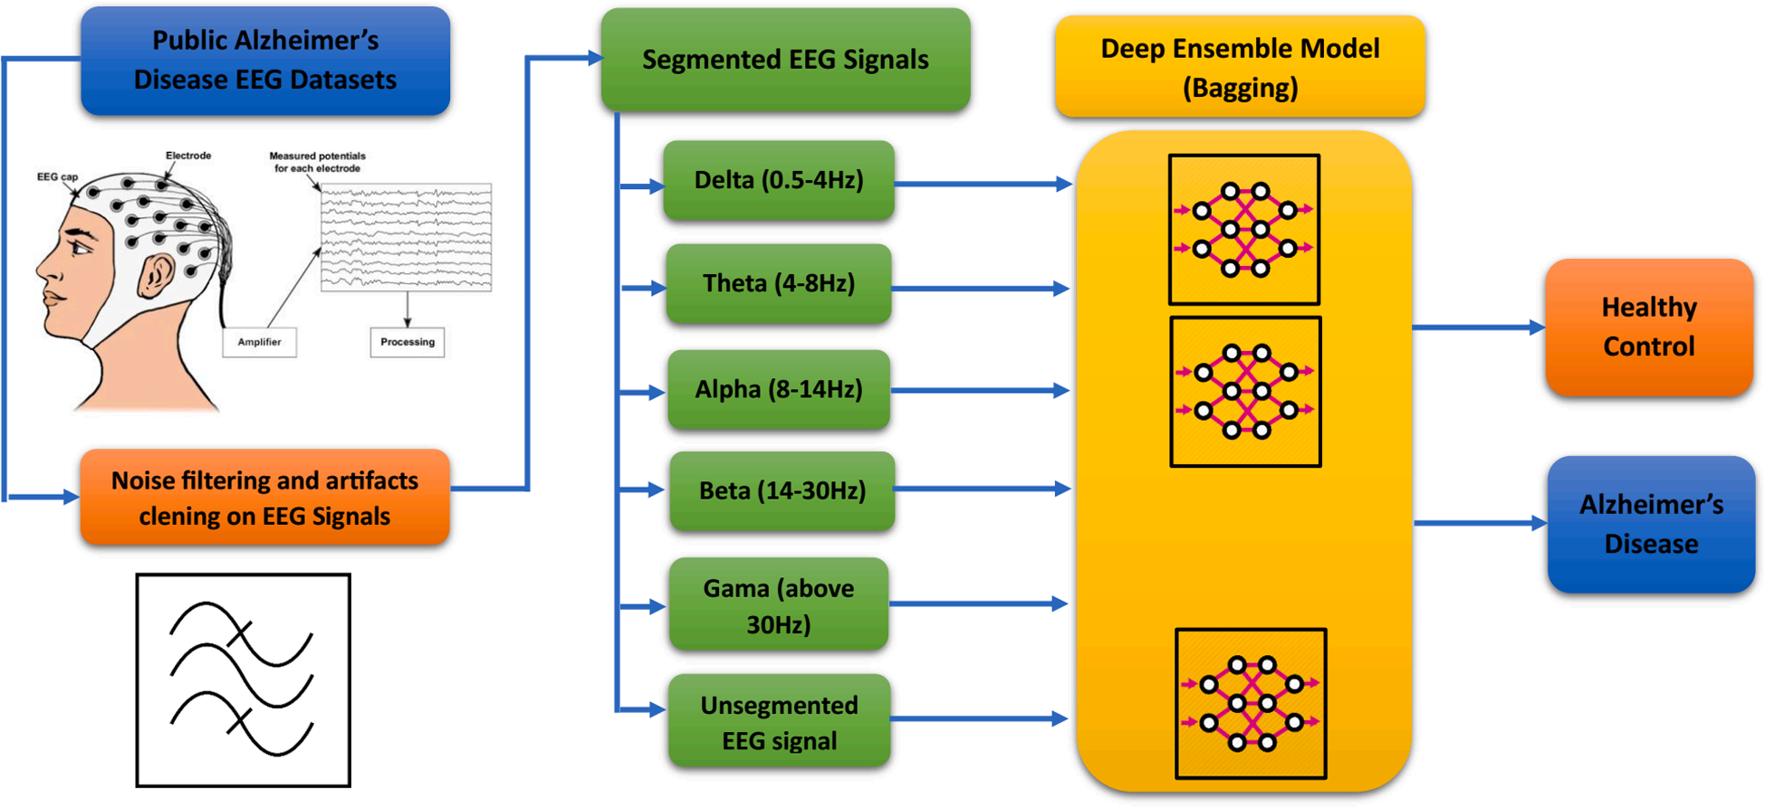
Introduction
EEG Processing
Block diagram AD diagnosis DEL model

Slide 40
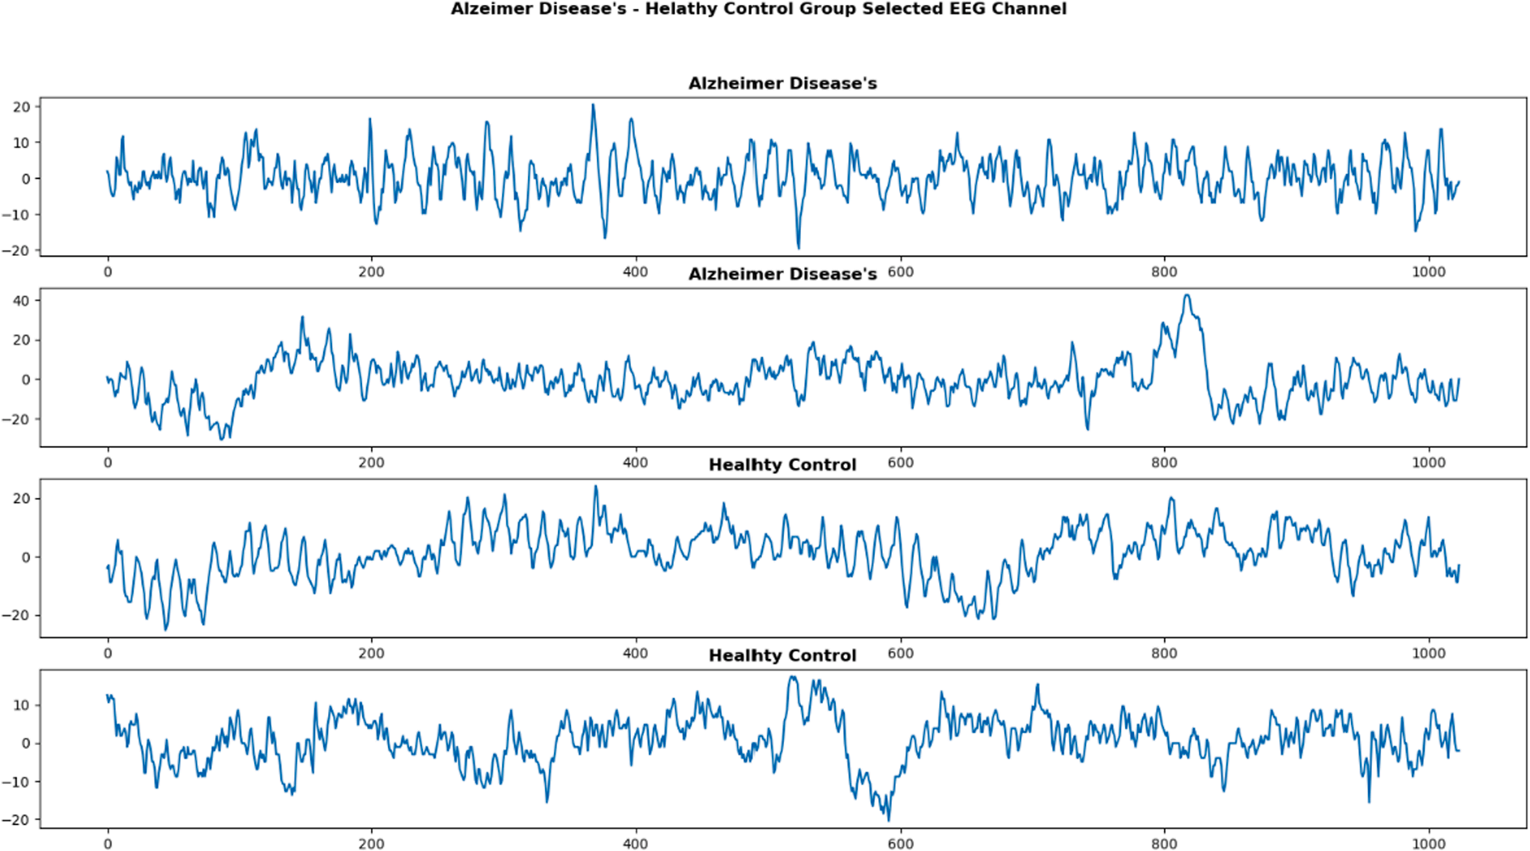
Introduction
EEG Processing
Alzheimer Disease’s (AD) – Healthy Control (HC) Group EEG signals.

Slide 41
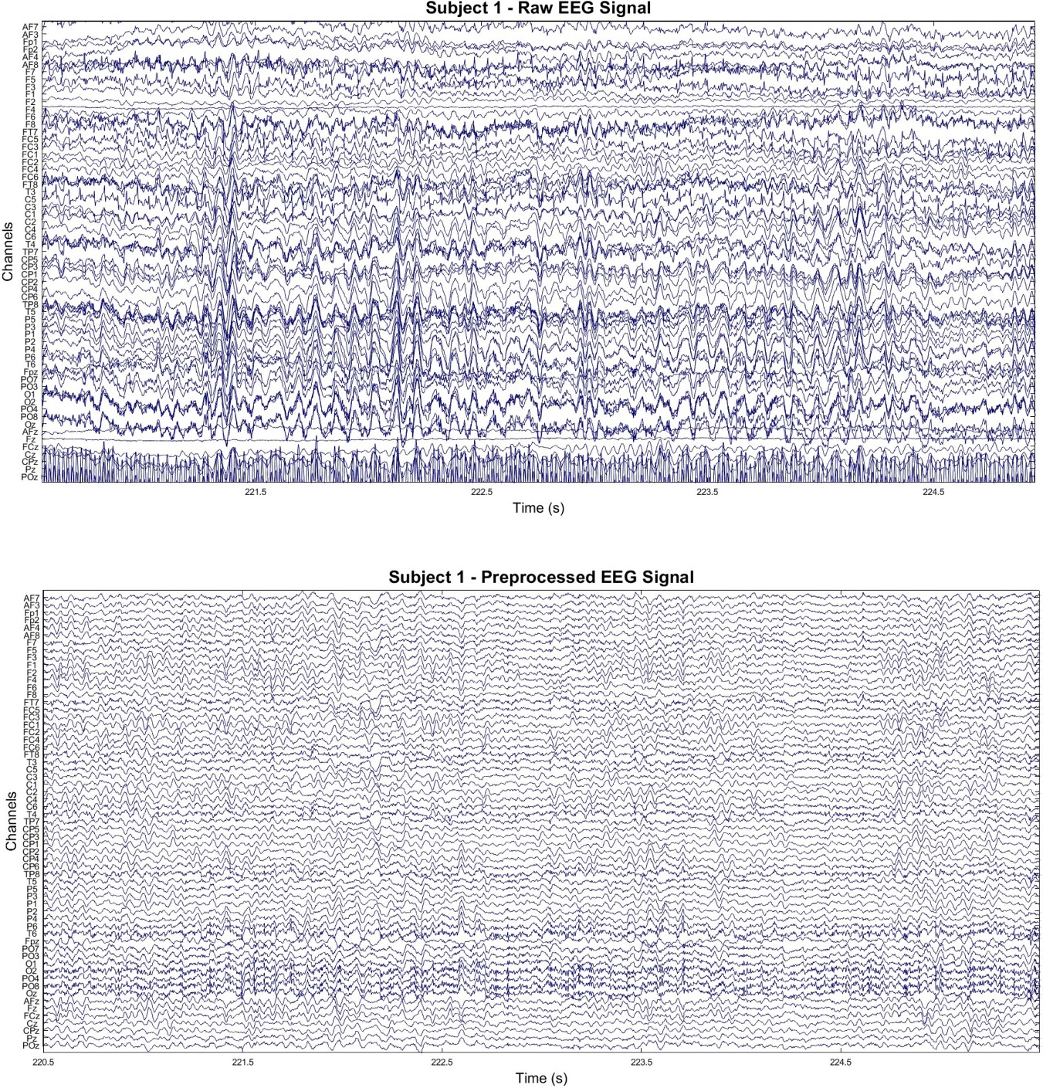
Introduction
EEG Processing
Sample EEG recordings of subject 1. (top) 5 s window of raw EEG signal. (bottom) Same window after preprocessing.

Slide 42
Introduction
EEG Feature Extraction
decompose it into other frequency bands, such as delta, theta, alpha, beta, and gamma
Each frequency band represents a diverse range of electrical activity in the brain
delta band :0.5-4 Hz, deep sleep and the maintenance of bodily functions
alpha band:8-13 Hz, attentional processes and relaxation

Slide 43
Introduction
EEG Feature Extraction
usually transformed to the frequency domain using
Fourier methodology such as Fast Fourier Transform (FFT)
Welch Power Spectral Density (PSD) analysis
transformed to the time-frequency domain using decomposition such as
Discrete Wavelet Transform (DWT)
Empirical Mode Decomposition (EMD)

Slide 44
Introduction
EEG Feature Extraction
After the transformation or analysis of EEG data with one of the following features are usually extracted to be fed to a Machine Learning framework for automatic detection, prediction, severity assessment, or evaluation of the given EEG task
abovementioned methodologies,
band power,
entropy,
fractal dimension, or
statistical

Slide 45
Introduction
EEG Feature Extraction
right choice of the feature selection method removed up to 82% of the EEG spectral features and increased the accuracy of the classifier more than 17%

Slide 46
Introduction
EEG time domain features for AD detection
Event-related potentials (ERP)
ERP are electric potentials elicited in the brain as a response to an auditory or visual stimulus.
Complexity
Brain activity in MCI and AD patients has lower complexity and irregularity compared to HC

Slide 47
Introduction
EEG Frequency domain analysis for AD detection
Coherence
This metric evaluates the synchrony between two signals. More formally, coherence refers to the normalized covariance of two signals in the spectral domain. In literature, authors have reported an increase of coherence in delta and theta rhythms, and a decrease in alpha and beta rhythms in MCI and AD
Relative power
This metric quantifies the proportion of power that is contained in an EEG sub band, compared to the total power of the signal. This means that the relative power in the fast rhythms (alpha and beta) decreases, while the relative power in the slow rhythms (delta and theta) increases.

Slide 48
Introduction
EEG Frequency domain analysis for AD detection
Fourier transform
This transform is used to decompose a time signal into a sum of sines and cosines of different frequencies and infinite length. spectral content of the EEG cannot be tracked by the Fourier transform, as the sines and cosines used in this transform are infinite length. Conversely, the wavelet transform represents a suitable alternative to address this issue.
Amplitude modulation
This methodology combines temporal and frequency analysis.

Slide 49
Introduction
performance evaluation methods
LOSO CV
most straightforward and clear model validation approach for AD classification. LOSO CV is the most suitable validation Amplitude modulation
K-fold
K-fold cross-validation is a common form of validation techniques and applied in most of articles
Leave-one-person-out-cross-validation (LOPO-CV) is another form of validation that is completely blind to the test subject and it makes the reported results more reliable

Slide 50
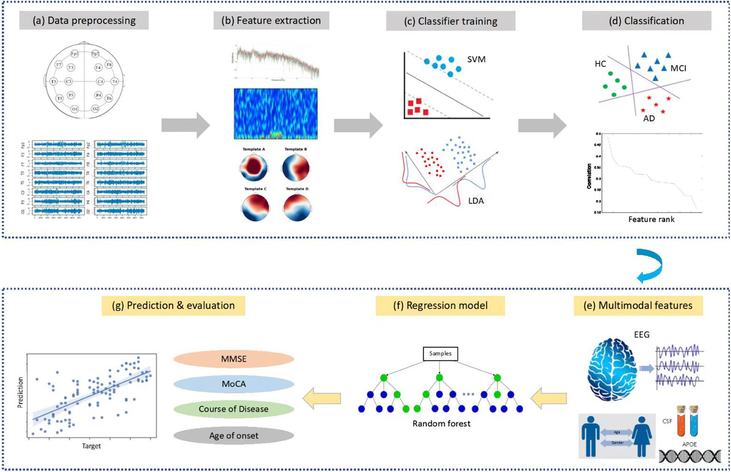
Methods
Overview
A total of 890 participants, including 189 patients with MCI, 330 patients with AD, 125 patients with other dementias and 246
Datasets are available from the corresponding author upon reasonable request
Jiao B, Li R, Zhou H, Qing K, Liu H, Pan H, et al. Neural biomarker diagnosis and prediction to mild cognitive impairment and Alzheimer’s disease using EEG technology. Alzheimer's Research & Therapy. 2023;15(1):32.

Slide 51
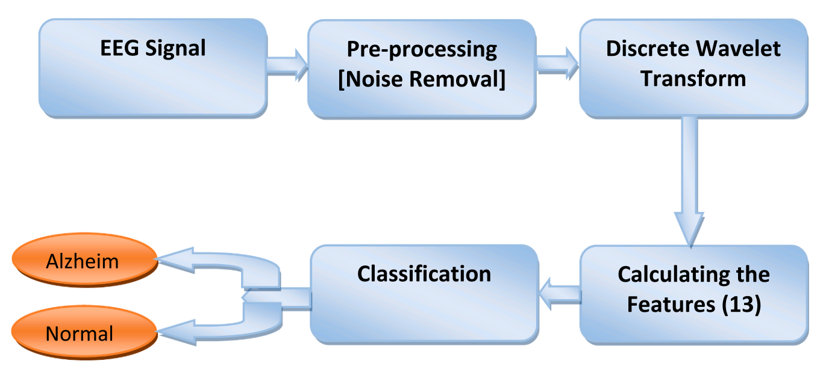
Methods
Three central lobe electrodes
This EEG dataset is available as open source.
The dataset contains 7 MCI, 59 AD, and 102 NC subjects
Highest performance of 96.55%
Fouad IA, El-Zahraa M. Labib F. Identification of Alzheimer’s disease from central lobe EEG signals utilizing machine learning and residual neural network. Biomedical Signal Processing and Control. 2023;86.

Slide 52
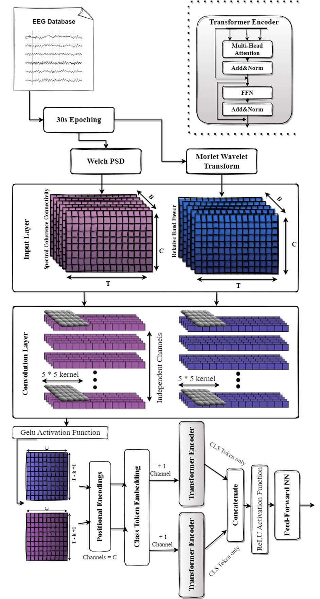
Methods
classification using a Dual-Input Convolution Encoder Network
: Recordings of 36 AD, 23 Frontotemporal dementia (FTD), and 29 age-matched healthy individuals (CN) were used
accuracy of 83.28% in the AD-CN problem using Leave-One-Subject-Out validation
Miltiadous A, Gionanidis E, Tzimourta KD, Giannakeas N, Tzallas AT. DICE-Net: A Novel Convolution-Transformer Architecture for Alzheimer Detection in EEG Signals. IEEE Access. 2023;11:71840-58.

Slide 53
Methods
First, each recording was divided into 30-second time windows with 15 seconds overlap to create the pool of EEG signals that will be used for the classification task. Next, the following two features have been extracted
Miltiadous A, Gionanidis E, Tzimourta KD, Giannakeas N, Tzallas AT. DICE-Net: A Novel Convolution-Transformer Architecture for Alzheimer Detection in EEG Signals. IEEE Access. 2023;11:71840-58.

Slide 54
Methods
extract two of the most promising biomarkers
Relative Band Power (RBP): increase in Theta/Alpha ratio in AD patients
Spectral Coherence Connectivity (SCC): decreased synchronization likelihood in AD patients
Miltiadous A, Gionanidis E, Tzimourta KD, Giannakeas N, Tzallas AT. DICE-Net: A Novel Convolution-Transformer Architecture for Alzheimer Detection in EEG Signals. IEEE Access. 2023;11:71840-58.

Slide 55
Methods
express them in image-like representations (3d matrixes)
fed in 2 parallel Convolution blocks
Miltiadous A, Gionanidis E, Tzimourta KD, Giannakeas N, Tzallas AT. DICE-Net: A Novel Convolution-Transformer Architecture for Alzheimer Detection in EEG Signals. IEEE Access. 2023;11:71840-58.

Slide 56
Methods
recordings from 88 participants
from Department of Neurology of AHEPA General University Hospital of Thessaloniki.
36 (13 males) of them were diagnosed with Alzheimer’s disease (AD group), 23 (14 males) were diagnosed with Frontotemporal Dementia (FTD group), and 29 (11 males) were healthy subjects (CN group)
Miltiadous A, Gionanidis E, Tzimourta KD, Giannakeas N, Tzallas AT. DICE-Net: A Novel Convolution-Transformer Architecture for Alzheimer Detection in EEG Signals. IEEE Access. 2023;11:71840-58.

Slide 57
Methods
The preprocessing pipeline of the EEG signals is as follows. First, a Butterworth band-pass filter 0.5-45 Hz was applied, and the signals were re-referenced to A1-A2. Then, the ASR routine [12] which is an automatic artifact reject method that can remove transient or large-amplitude artifacts
Miltiadous A, Gionanidis E, Tzimourta KD, Giannakeas N, Tzallas AT. DICE-Net: A Novel Convolution-Transformer Architecture for Alzheimer Detection in EEG Signals. IEEE Access. 2023;11:71840-58.

Slide 58
Methods
We made the dataset publicly available
Miltiadous A, Gionanidis E, Tzimourta KD, Giannakeas N, Tzallas AT. DICE-Net: A Novel Convolution-Transformer Architecture for Alzheimer Detection in EEG Signals. IEEE Access. 2023;11:71840-58.

Slide 59
Methods
This paper divides EEG signals into 5 frequency bands with a Butterworth band-pass filter. EEG signals recorded as 8 s in the datasets were segmented into 1 s epochs. An epoch was converted into a 2D array of 128x19. A total of 1120 epochs consist of two datasets combined. Then, EEG signals for each frequency band (delta, theta, alpha, beta, and gamma) were segmented into 1 s epochs (128x19 2D array) and given as input to ensemble learning
With 5 cross-fold training, the average accuracy of the DEL model reached 97.9% ± 1.1%.
Nour M, Senturk U, Polat K. A novel hybrid model in the diagnosis and classification of Alzheimer's disease using EEG signals: Deep ensemble learning (DEL) approach. Biomedical Signal Processing and Control. 2024;89.

Slide 60
Methods
Two datasets were used
We can send the datasets at the request of the authors
Nour M, Senturk U, Polat K. A novel hybrid model in the diagnosis and classification of Alzheimer's disease using EEG signals: Deep ensemble learning (DEL) approach. Biomedical Signal Processing and Control. 2024;89.

Slide 61
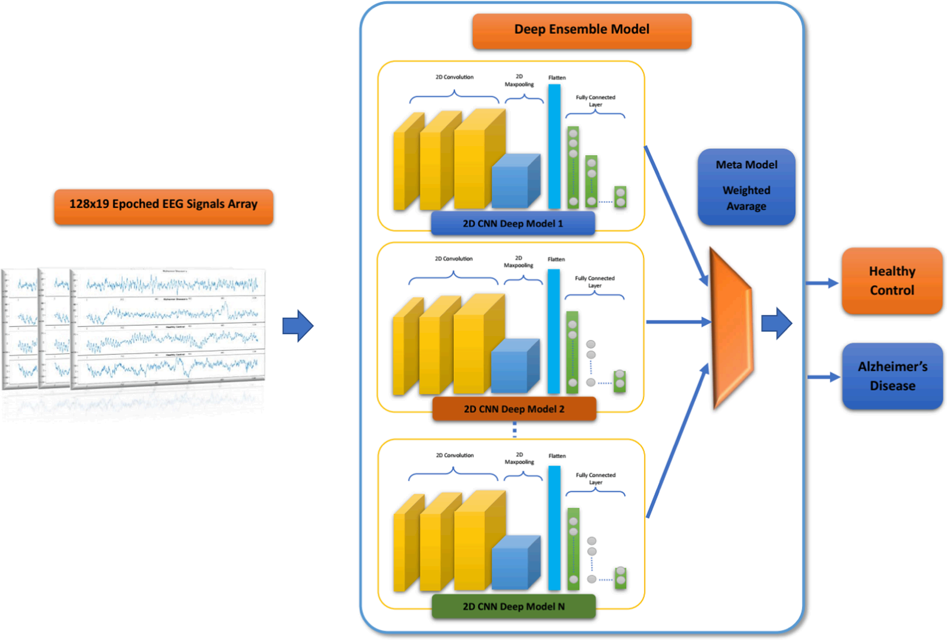
Methods
. The proposed Deep Ensemble Learning (DEL) Models for AD-HC Classification
Nour M, Senturk U, Polat K. A novel hybrid model in the diagnosis and classification of Alzheimer's disease using EEG signals: Deep ensemble learning (DEL) approach. Biomedical Signal Processing and Control. 2024;89.

Slide 62
Methods
Five different datasets were created by extracting delta, theta, alpha, beta and delta-to-theta frequency bands using bandpass filters.
delta dataset allowed our model to achieve the best performances for the discrimination of SCD and MCI, reaching an Area Under the ROC Curve (AUC) of 0.807
esults for the HC vs SCD vs MCI classification were obtained on alpha and theta with a micro-AUC higher than 0.74.
Sibilano E, Brunetti A, Buongiorno D, Lassi M, Grippo A, Bessi V, et al. An attention-based deep learning approach for the classification of subjective cognitive decline and mild cognitive impairment using resting-state EEG. Journal of Neural Engineering. 2023;20(1):016048.

Slide 63
Methods
Firstly, raw EEG signals are preprocessed
19 channels are selected and 4 frequency bands (δ, θ, α and β) are extracted
obtaining four distinct datasets and a fifth one using the δ-to-β range.
perform both two- and three-class classifications of epochs through LOSOCV.
Finally, a majority voting approach is used to label each subject in the test set either as HC, SCD or MCI based on the class assigned to its epochs.
Sibilano E, Brunetti A, Buongiorno D, Lassi M, Grippo A, Bessi V, et al. An attention-based deep learning approach for the classification of subjective cognitive decline and mild cognitive impairment using resting-state EEG. Journal of Neural Engineering. 2023;20(1):016048.

Slide 64
Methods
transformers
higher ability to deal with long-range dependencies
recognize patterns in sequences of data
more interpretable decision-making processes
recent efforts in exploring their applications on timeseries data, such as EEG or electromyography signals,are showing interesting results
Sibilano E, Brunetti A, Buongiorno D, Lassi M, Grippo A, Bessi V, et al. An attention-based deep learning approach for the classification of subjective cognitive decline and mild cognitive impairment using resting-state EEG. Journal of Neural Engineering. 2023;20(1):016048.

Slide 65
Methods
The electrodes were placed according to the 10–10 montage system and electrode-skin impedance was set below 5 kΩ. Subjects were sat in a reclined chair for approximately 20 min.
A cluster of 19 channels, namely Fp1, Fp2, F7, F3, Fz, F4, F8, T3, C3, Cz, C4, T4, T5, P3, Pz, P4, T6, O1, O2, was then selected. Since these channels evenly cover the scalp area, this EEG pattern is the most employed in the literature for similar studies [56] and has been proven to ensure sufficient quality along with possible comparison with previous rsEEG findings of other projects
Sibilano E, Brunetti A, Buongiorno D, Lassi M, Grippo A, Bessi V, et al. An attention-based deep learning approach for the classification of subjective cognitive decline and mild cognitive impairment using resting-state EEG. Journal of Neural Engineering. 2023;20(1):016048.

Slide 66
Methods
adding more spatial details by using all available 61 EEG channels, instead of a cluster of 19 channels, not only did not improve the performances of the model
Sibilano E, Brunetti A, Buongiorno D, Lassi M, Grippo A, Bessi V, et al. An attention-based deep learning approach for the classification of subjective cognitive decline and mild cognitive impairment using resting-state EEG. Journal of Neural Engineering. 2023;20(1):016048.

Slide 67
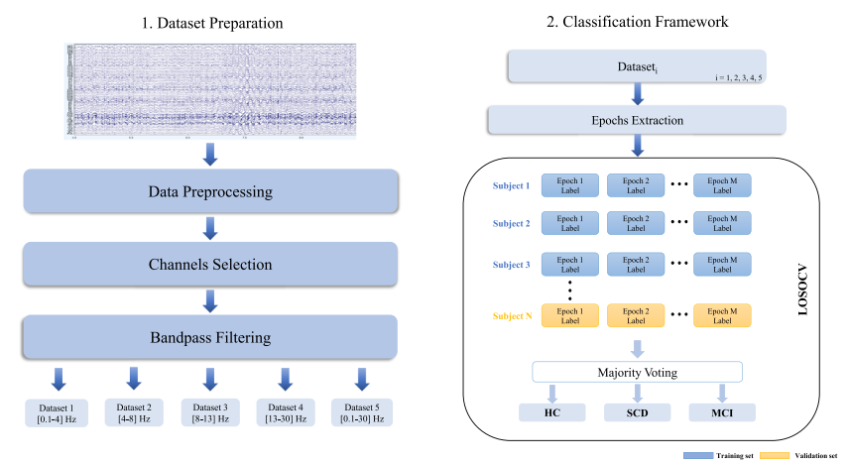
Methods
Workflow of the proposed method
Sibilano E, Brunetti A, Buongiorno D, Lassi M, Grippo A, Bessi V, et al. An attention-based deep learning approach for the classification of subjective cognitive decline and mild cognitive impairment using resting-state EEG. Journal of Neural Engineering. 2023;20(1):016048.

Slide 68
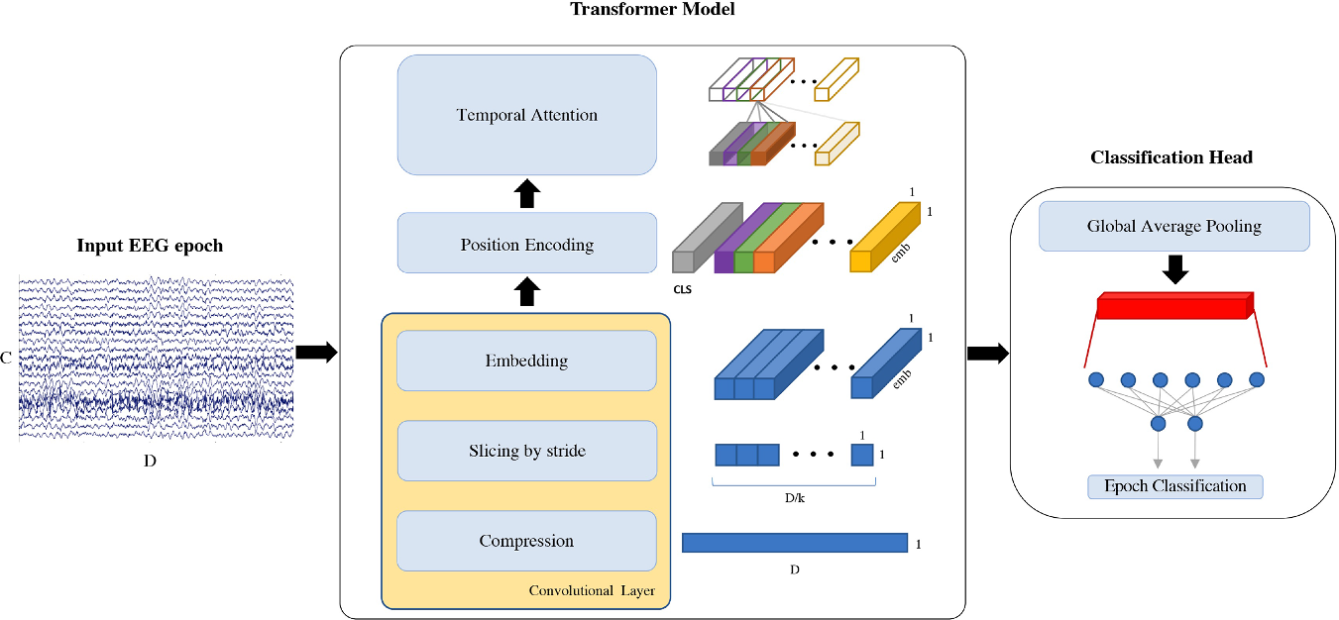
Methods
EEG epoch classification pipeline. Each EEG segment of C = 19 channels and D = 5120 datapoints is used as input to our model, which uses a convolutional layer to compress the signal, extract slices and embed the information. k = 31 is the size of the kernel, emb = 6 is the embeddings’ dimension and CLS is the classification token prepended to the input. Attention mechanism is then applied on the temporal domain and, after global average pooling, a linear layer is used to classify the input EEG epoch
Sibilano E, Brunetti A, Buongiorno D, Lassi M, Grippo A, Bessi V, et al. An attention-based deep learning approach for the classification of subjective cognitive decline and mild cognitive impairment using resting-state EEG. Journal of Neural Engineering. 2023;20(1):016048.

Slide 69
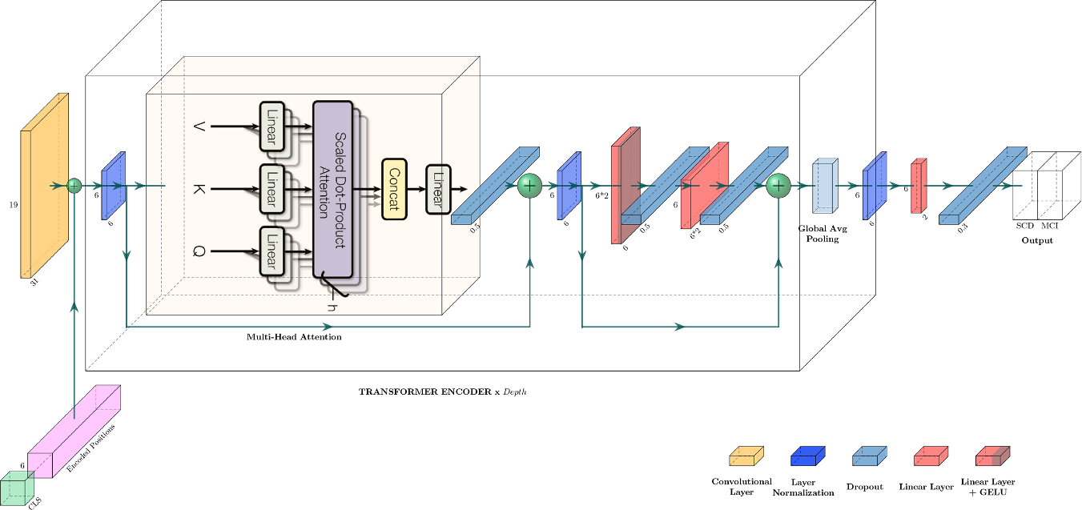
Methods
Proposed transformer architecture. CLS is the classification token, h = 3 is the number of heads used by multi-head attention and Depth = 2 indicates the number of times the transformer encoder block is repeated. A legend for uncaptioned blocks is provided on the bottom right corner
Sibilano E, Brunetti A, Buongiorno D, Lassi M, Grippo A, Bessi V, et al. An attention-based deep learning approach for the classification of subjective cognitive decline and mild cognitive impairment using resting-state EEG. Journal of Neural Engineering. 2023;20(1):016048.

Slide 70
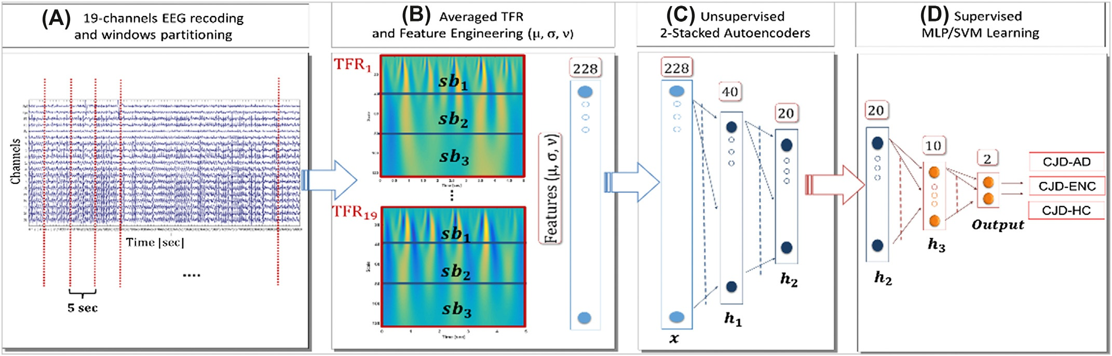
Methods
(A) The 19-channel EEG recording is partitioned into N nonoverlapping 5s windows. (B) For each EEG epoch, and for every EEG channel a time-frequency representation (TFR) is computed. The TFRs are averaged over epochs resulting in 19 averaged TFRs (one per channel). Each averaged TFR is subdivided into three subbands, and then, the mean (μ), the standard deviation (σ), and the skewness (v) are estimated both for the subbands and for the whole TFR. Therefore, 1219¼228 engineered features are extracted and are used to train 2 stacked autoencoders (UL). (C) The first autoencoder (AE1, 228:40:228) compresses the input representation in 40 parameters (h1). The second autoencoder (AE2, 40:20:40) compresses the 40 learned features in 20 higher-level paraments (h2). Finally, a classifier with a single hidden layer (h3) of 10 neurons is trained (SL)
Morabito, F. C., et al. (2017). "Deep Learning Representation from Electroencephalography of Early-Stage Creutzfeldt-Jakob Disease and Features for Differentiation from Rapidly Progressive Dementia." Int J Neural Syst 27(2): 1650039.

Slide 71
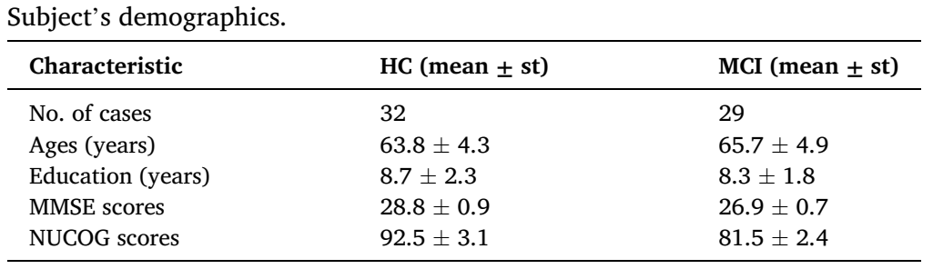
Methods
The study analyzed a total of eight EEG features obtained from 21 channels.
he study only considers the two-, four-, six-, and eight-channels under the restrictive condition of symmetric channel pairs. For example, in the case of evaluating the accuracies of two channels, the Fp1 channel is selected only with the Fp2 channel, the F7 channel is selected with only the F8, the O1 channel is selected with only the O2, and so on
The suggested methods are examined with two public datasets that are both available in [34]
Aljalal, M., et al. (2024). "Mild cognitive impairment detection with optimally selected EEG channels based on variational mode decomposition and supervised machine learning." Biomedical Signal Processing and Control 87.

Slide 72
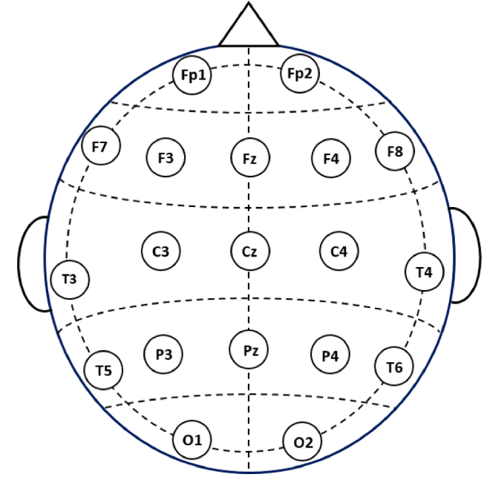
Methods
The 19 channels locations used in this study
Aljalal, M., et al. (2024). "Mild cognitive impairment detection with optimally selected EEG channels based on variational mode decomposition and supervised machine learning." Biomedical Signal Processing and Control 87.

Slide 73
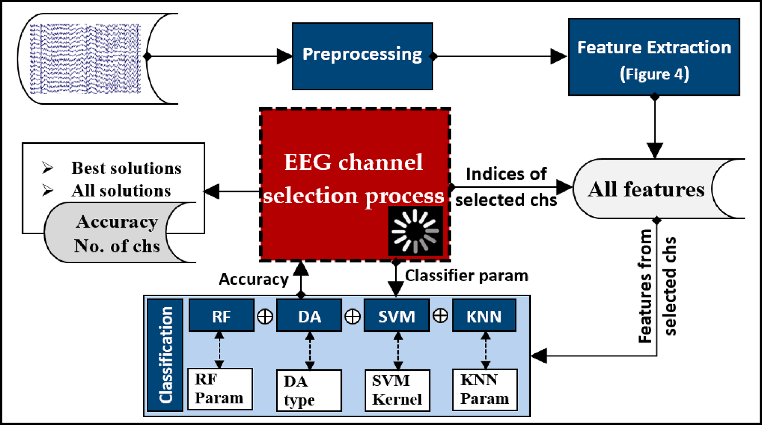
Methods
High-level overview of EEG signal processing and channel selection process
Aljalal, M., et al. (2024). "Mild cognitive impairment detection with optimally selected EEG channels based on variational mode decomposition and supervised machine learning." Biomedical Signal Processing and Control 87.

Slide 74
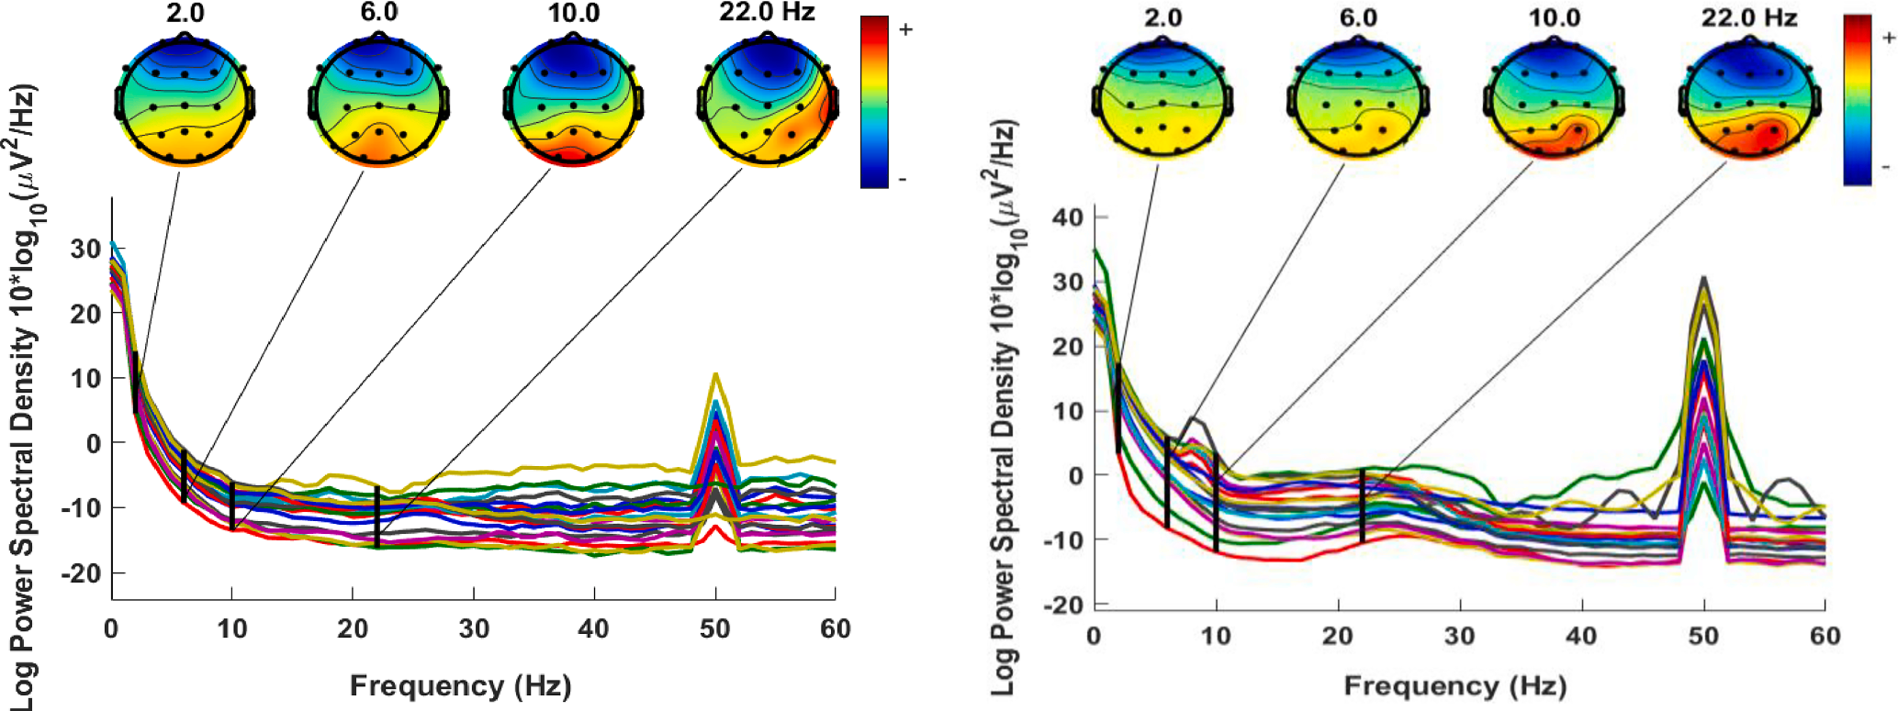
Methods
PSD and electrodes map for HC EEG (left) and MCI EEG (right).
the electrode maps are offered for four additional arbitrary frequencies: 2, 6, 10, and 22 Hz. In general, in both cases, the low-frequency spectrum has a higher power density than the high-frequency spectrum
Aljalal, M., et al. (2024). "Mild cognitive impairment detection with optimally selected EEG channels based on variational mode decomposition and supervised machine learning." Biomedical Signal Processing and Control 87.

Slide 75
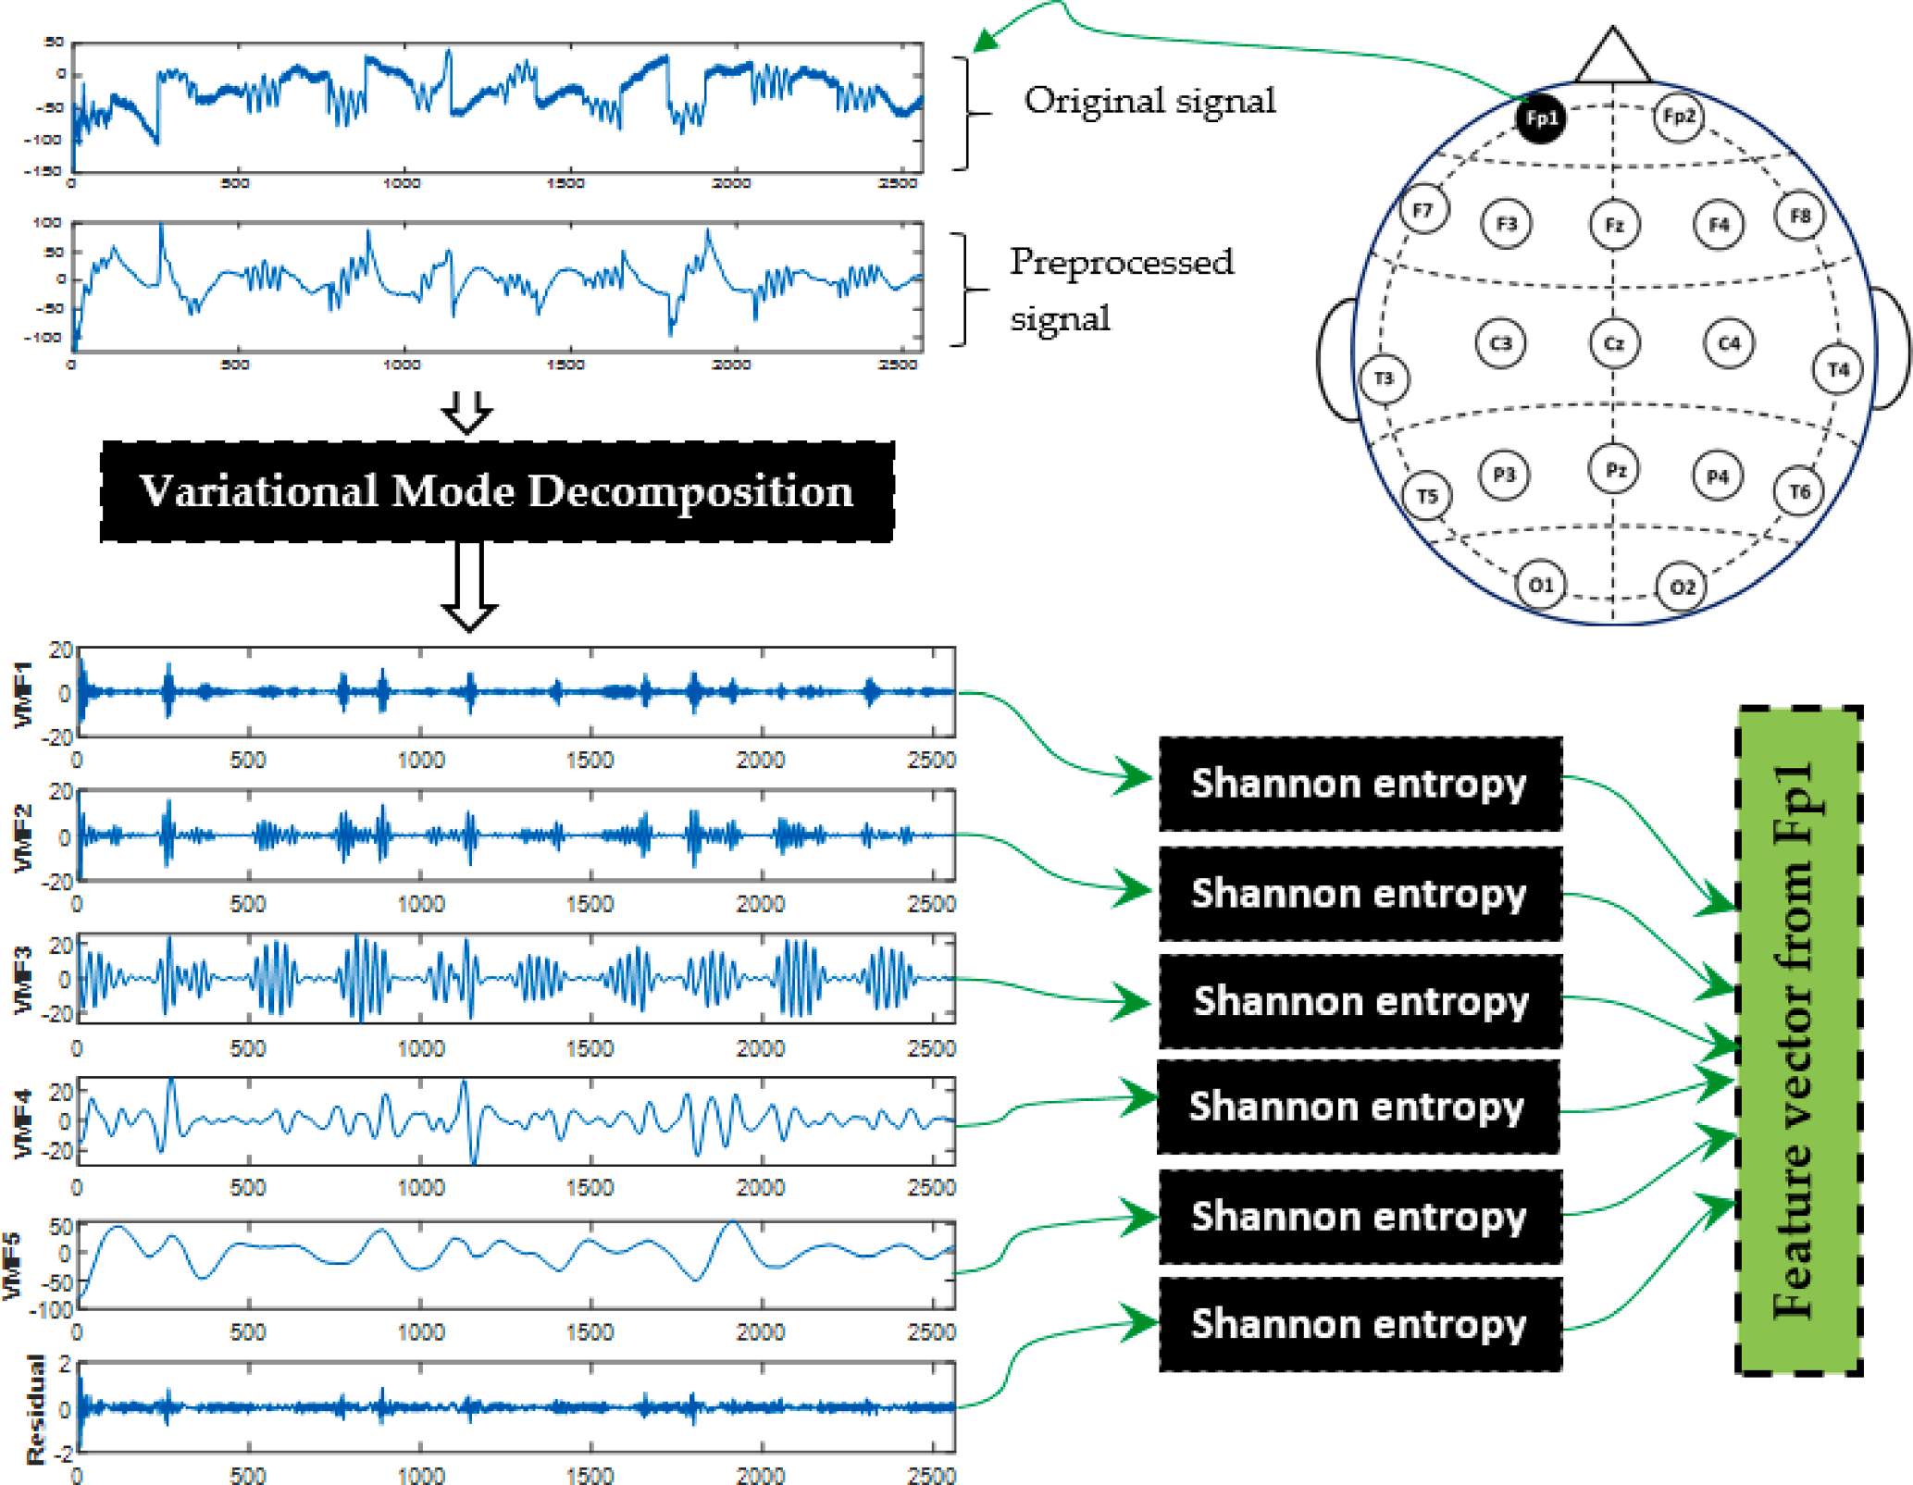
Methods
Example of feature extraction from a 10 sec segment using VMD and Shannon entropy.
Aljalal, M., et al. (2024). "Mild cognitive impairment detection with optimally selected EEG channels based on variational mode decomposition and supervised machine learning." Biomedical Signal Processing and Control 87.

Slide 76
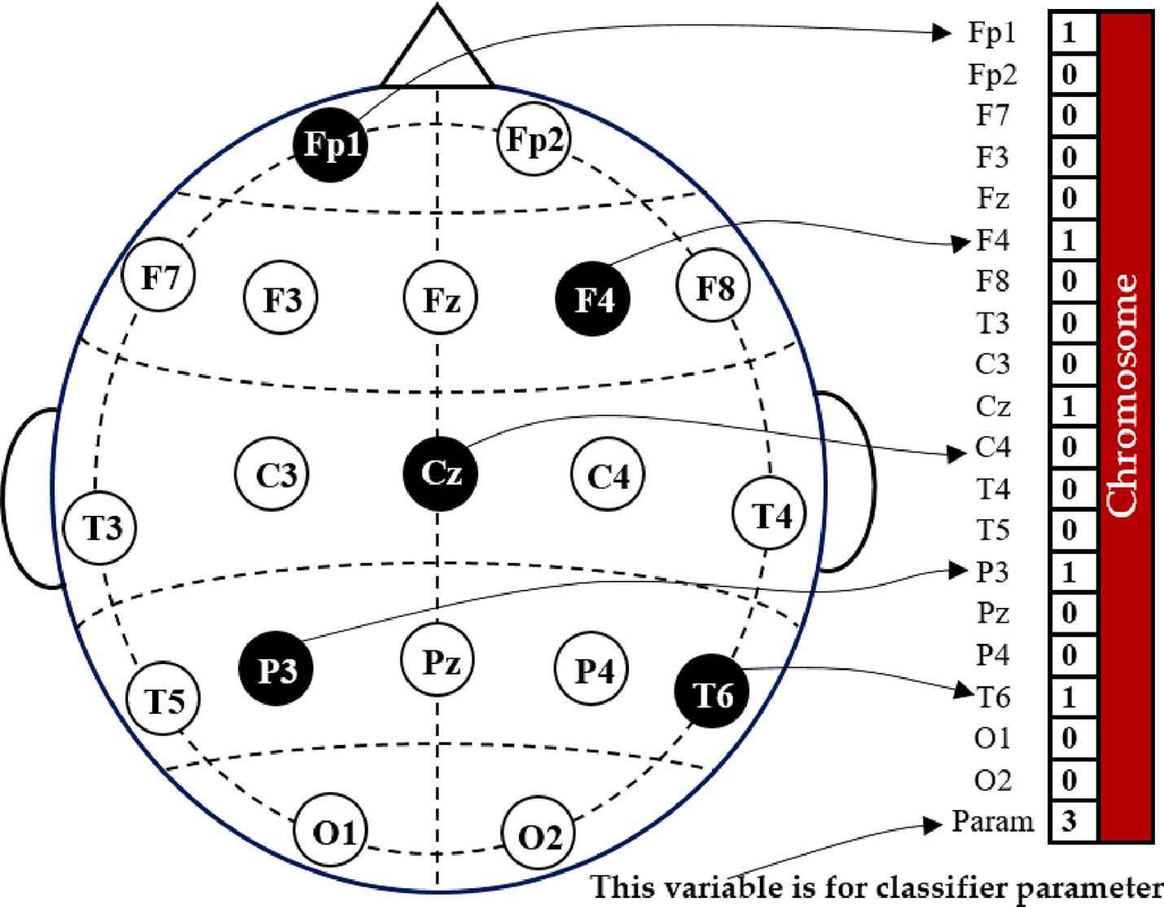
Methods
Example of channel representation in a chromosome for NSGA
Aljalal, M., et al. (2024). "Mild cognitive impairment detection with optimally selected EEG channels based on variational mode decomposition and supervised machine learning." Biomedical Signal Processing and Control 87.

Slide 77
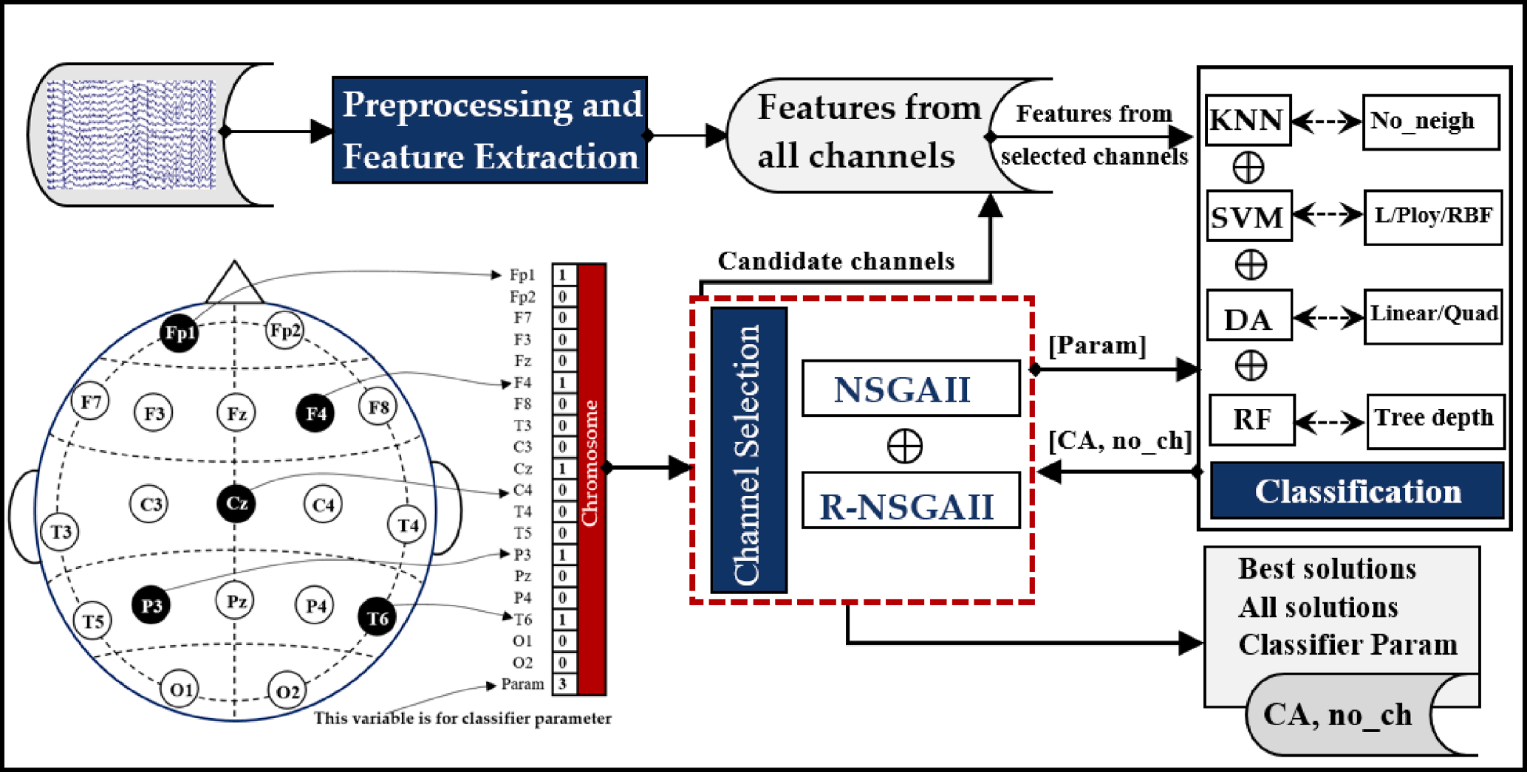
Methods
Process overview for EEG channel selection using NSGA for MCI classification
the highest full-channel accuracy (i.e., using all 19 EEG channels) is 99.51%
Aljalal, M., et al. (2024). "Mild cognitive impairment detection with optimally selected EEG channels based on variational mode decomposition and supervised machine learning." Biomedical Signal Processing and Control 87.

Slide 78
Methods
EEG data is imported and bandpass filtering in the range [0.5 Hz, 70 Hz] is done to remove environmental/muscle noise in scalp EEG. After creating epochs with a window size of 0.25 s and removing bad epochs from the data, independent component analysis (ICA) is applied, and bad channels are manually removed. The dataset is used with a sampling rate of 128 Hz, the same as during acquisition.
Accuracies of 94.68% (gender), 87.63% (age), 95.59% (two workload levels), and 89.40% (three workload levels) were achieved
This proves the effectiveness of the transformers for processing raw EEG data and can reduce the need for feature extraction in EEG .
Siddhad, G., et al. (2024). "Efficacy of transformer networks for classification of EEG data." Biomedical Signal Processing and Control 87: 105488.

Slide 79
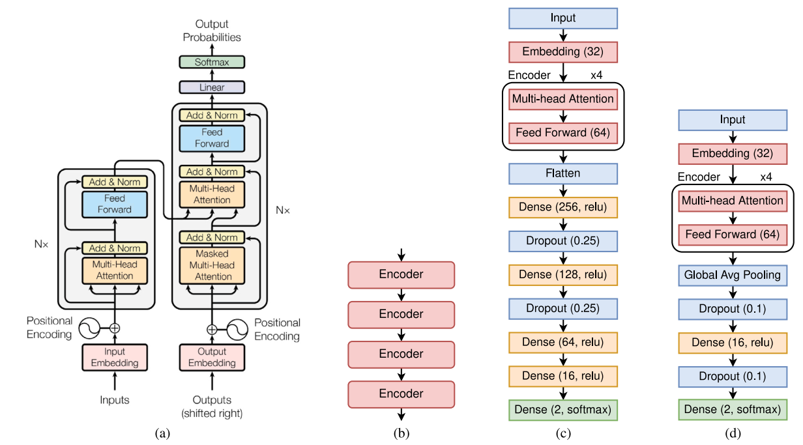
Methods
Network architecture for (a) Original transformer network [1] (left is encoder and decoder is on the right); (b) Arrangement of encoders in transformer block (stack of 4 encoders are used in the proposed method); Proposed architecture for (c) Age and Gender, and (d) STEW dataset
Siddhad, G., et al. (2024). "Efficacy of transformer networks for classification of EEG data." Biomedical Signal Processing and Control 87: 105488.

Slide 80
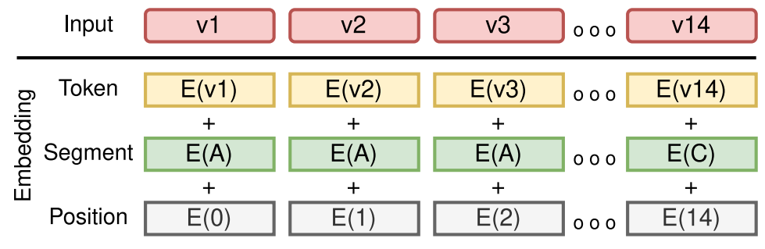
Methods
This figure shows the working of embedding and positional encoding. E with numbers represents the position embedding, E with different alphabets represents different segments, and E with various v represents the token vectors for the input. These are sum together to produce the input for the transformer network
Siddhad, G., et al. (2024). "Efficacy of transformer networks for classification of EEG data." Biomedical Signal Processing and Control 87: 105488.

Slide 81
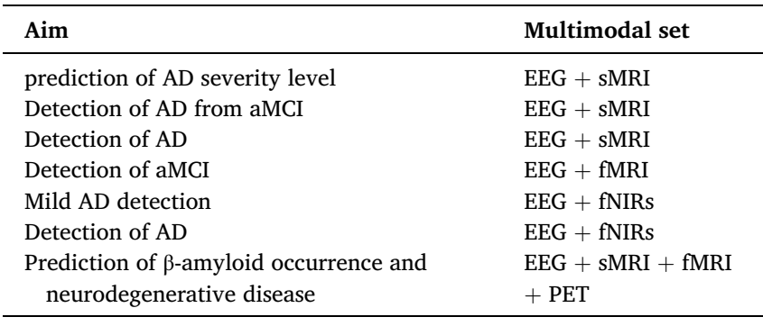
Methods
Multimodal neuroimaging system and their aim in AD assessment
Modir, A., et al. (2023). "A systematic review and methodological analysis of EEG-based biomarkers of Alzheimer's disease." Measurement 220.

Slide 82
Methods
An intriguing rsEEG application is the monitoring and evaluation of AD progression in large populations with few electrodes in low-cost devices. Clinical and rsEEG data acquired in hospital settings (10-20 montage) from 75 ADMCI participants and 70 age-, education-, and sex-matched normal elderly controls (Nold) were available in an Italian-Turkish archive (PDWAVES Consortium; www.pdwaves.eu). Standard spectral fast fourier transform (FFT) analysis of rsEEG data for individual delta, theta, and alpha frequency bands was computed from 6 monopolar scalp electrodes to derive bipolar C3-P3, C4-P4, P3-O1, and P4-O2 markers. The ADMCI group showed increased delta and decreased alpha power density at the C3-P3, C4-P4, P3-O1, and P4-O2 bipolar channels compared to the Nold group. Increased theta power density for ADMCI patients was observed only at the C3-P3 bipolar channel. Best classification accuracy between the ADMCI and Nold individuals reached 81% (area under the receiver operating characteristic curve) using Alpha2/Theta power density computed at the C3-P3 bipolar channel. Standard rsEEG power density computed from six posterior bipolar channels characterized ADMCI status.
Tucci, F., et al. (2023). "What a single electroencephalographic (EEG) channel can tell us about Alzheimer's disease patients with mild cognitive impairment." Alzheimer's & Dementia 19(S2): e062375.

Slide 83
Methods
. We used rsEEG data in Nold and ADMCI patients from an international database (www.pdwaves.eu) and performed a standard spectral FFT analysis of rsEEG activity at individual delta, theta, and alpha frequency bands.
To evaluate the study hypotheses, clinical, neuropsychological, anthropometric, genetic, cerebrospinal fluid (CSF), MRI, and rsEEG data in 70 Nold and 75 ADMCI subjects from an international archive were used in the present study. The following Italian and Turkish clinical units enrolled the participants: the Sapienza University of Rome (Italy), Institute for Research and Evidence-based Care (IRCCS) “Fatebenefratelli” of Brescia (Italy), IRCCS SDN of Naples (Italy), IRCCS Oasi Maria SS of Troina (Italy), IRCCS Ospedale Policlinico San Martino and DINOGMI (University of Genova, Italy), Hospital San Raffaele of Cassino (Italy), IRCCS San Raffaele Pisana of Rome (Italy) and Medipol University of Istanbul (Turkey).
Tucci, F., et al. (2023). "What a single electroencephalographic (EEG) channel can tell us about Alzheimer's disease patients with mild cognitive impairment." Alzheimer's & Dementia 19(S2): e062375.

Slide 84
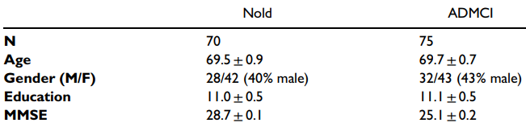
Methods
Demographic and clinical data in Nold and ADMCI
Tucci, F., et al. (2023). "What a single electroencephalographic (EEG) channel can tell us about Alzheimer's disease patients with mild cognitive impairment." Alzheimer's & Dementia 19(S2): e062375.

Slide 85
Methods
To this aim, we included the clinical and rsEEG data from an international archive acquired in hospital settings (10-20 electrode montage) from 75 ADMCI participants and 70 age-, education-, and sex-matched Nold seniors. Standard spectral FFT analysis of rsEEG data for individual delta, theta, and alpha frequency bands was computed from 6 monopolar scalp electrodes to derive bipolar C3-P3, C4-P4, P3-O1, and P4-O2 spectral markers. The ADMCI group showed increased delta power density and decreased alpha power density at the C3-P3, C4-P4, P3-O1, and P4-O2 bipolar channels. Increased theta power density for ADMCI patients was observed only at the C3-P3 bipolar channel. Best classification accuracy between the ADMCI and Nold individuals reached 81% (area under the receiver operating characteristic curve) using Alpha2/Theta power density computed at the C3-P3 bipolar channel.
Tucci, F., et al. (2023). "What a single electroencephalographic (EEG) channel can tell us about Alzheimer's disease patients with mild cognitive impairment." Alzheimer's & Dementia 19(S2): e062375.

Slide 86
Methods
The author(s) disclosed receipt of the following financial support for the research, authorship, and/or publication of this article: This work was supported by the Ministero della Salute, (grant number Ricerca Corrente” )
Tucci, F., et al. (2023). "What a single electroencephalographic (EEG) channel can tell us about Alzheimer's disease patients with mild cognitive impairment." Alzheimer's & Dementia 19(S2): e062375.

Slide 87
Methods
In this paper, two different deep learning (DL) architectures, including modified convolutional (CNN) and convolutional autoencoder (Conv-AE) neural networks (NNs), are proposed for classifying subjects into AD, mild cognitive impairment (MCI), and healthy control (HC)
Continuous wavelet transform (CWT) with Mexican hat function (MHf) as its mother wavelet is used for the selected TFR
The average accuracy obtained for the modified convolutional network and the convolutional auto-encoder network are 92% and 89%, respectively
Fouladi, S., et al. (2022). "Efficient Deep Neural Networks for Classification of Alzheimer’s Disease and Mild Cognitive Impairment from Scalp EEG Recordings." Cognitive Computation 14(4): 1247-1268.

Slide 88
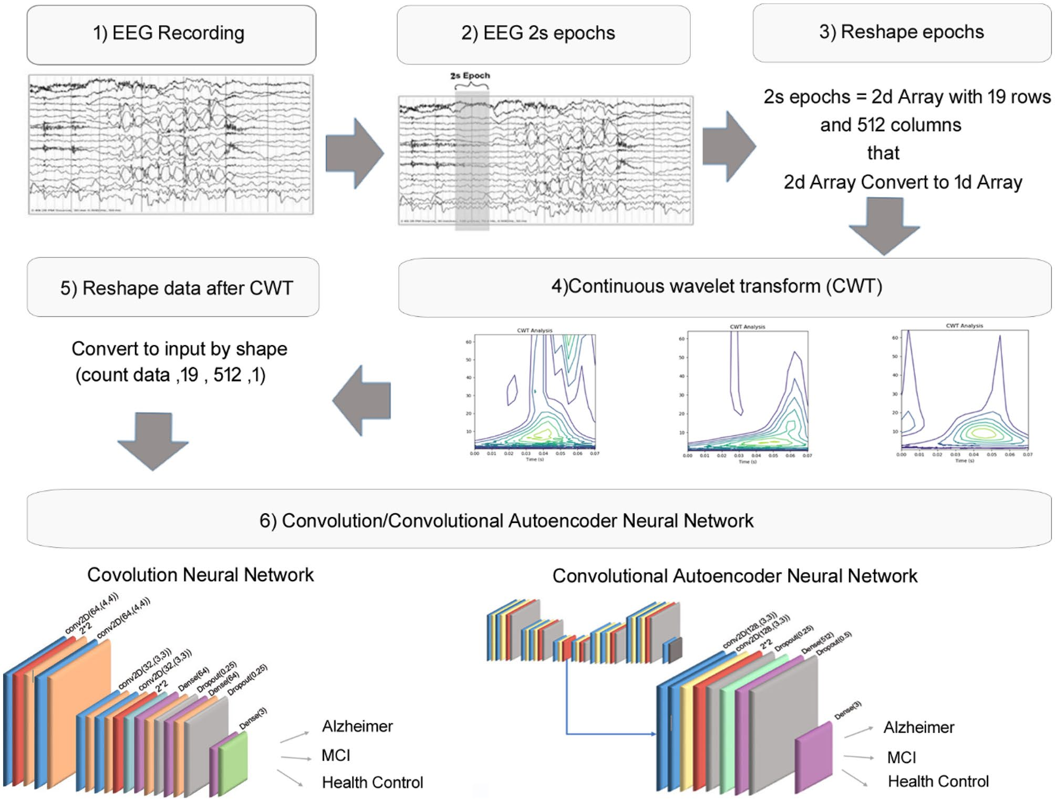
Methods
19-channel
90 subjects
37 AD
37 MCI
16 HC
recorded in 5-m
Fouladi, S., et al. (2022). "Efficient Deep Neural Networks for Classification of Alzheimer’s Disease and Mild Cognitive Impairment from Scalp EEG Recordings." Cognitive Computation 14(4): 1247-1268.

Slide 89
Future Works
Evaluate the effectiveness of EEG techniques in diagnosing different types of dementias
Longitudinal studies to assess whether EEG biomarkers can be used to trace the progress trajectory of AD or evaluate the efficacy of pharmacological/therapeutic interventions for AD patients.
the model’s accuracy can be further improved using regularization techniques
interpretability

Slide 90
Future Works
other neurological disorders, such as Parkinson’s, epilepsy, and stroke, to diagnose and classify various diseases
In transformer model improvement of the proposed model, which could include the application of a spatial attention module on the EEG channels, is worth exploring
study of new features that support the early detection of AD

Slide 91
Future Works
There have been many studies on EEG analysis using machine learning techniques to detect various neurological conditions, such as Parkinson’s disease (PD), major depressive disorder, autism spectrum disorder (ASD), epilepsy, AD, schizophrenia, and and emotion recognition as well
introducing an EEG-based biomarker or a combined biomarker consisting of EEG and other neuroimaging techniques is more valuable than the others in the category of the detection and automatic classification of these three stages of AD.

Slide 92
Future Works
it is suggested to develop a novel deep neural network architecture that automatically explains its reason for each output prediction. In this case, physicians and health providers are convinced to use them and trust them for decision-making

Slide 93
References
Molecular Biology, Not Only for Bioinformaticians. Istrail, 2013
From sequence to function through structure: Deep learning for protein design
NoeliaFerruz -2023

Slide 94
Thank You

